Slide 1
Workforce Management Maturity 2020
Research Data Highlights
2021

Slide 2
Demographics: Workforce Management Maturity 2020
128
Respondents
Geographic Distribution:
16%
Organizations with multiple locations across the globe
41%
Small (1-499 employees)
40%
Organizations located in one country with multiple locations
28%
Medium (500-4,999 employees)
Organizations located in one country with some global distribution
12%
31%
32%
Organizations located in one country in one location
Large (5,000+ employees)
Top Five Industries: Technology & Software, Healthcare, Education, Manufacturing and Government

Slide 3
Introduction
This presentation provides an overview of Brandon Hall Group’s Workforce Management Maturity Study, conducted in 2020.
It includes a look at how organizations fall on the workforce management maturity curve and what they are doing to improve, as well as analysis and critical questions that organizations need to answer and our point of view on the research.

Slide 4
Current State
When it comes to workforce-management maturity, it’s safe to say that most organizations are stuck in the middle. In fact, 59% of all organizations see themselves at the stage where they have identified the issue but have only begun to put processes in place to give themselves a strategic edge. Yet, it will be difficult to move toward a strategic future when the current state doesn’t allow for a more long-term view, which is only held by 13% of organizations. Clearly, the way forward will be to prove the value of workforce management to every organization. There is no company that could not gain from implementing a more strategic process.

Slide 5
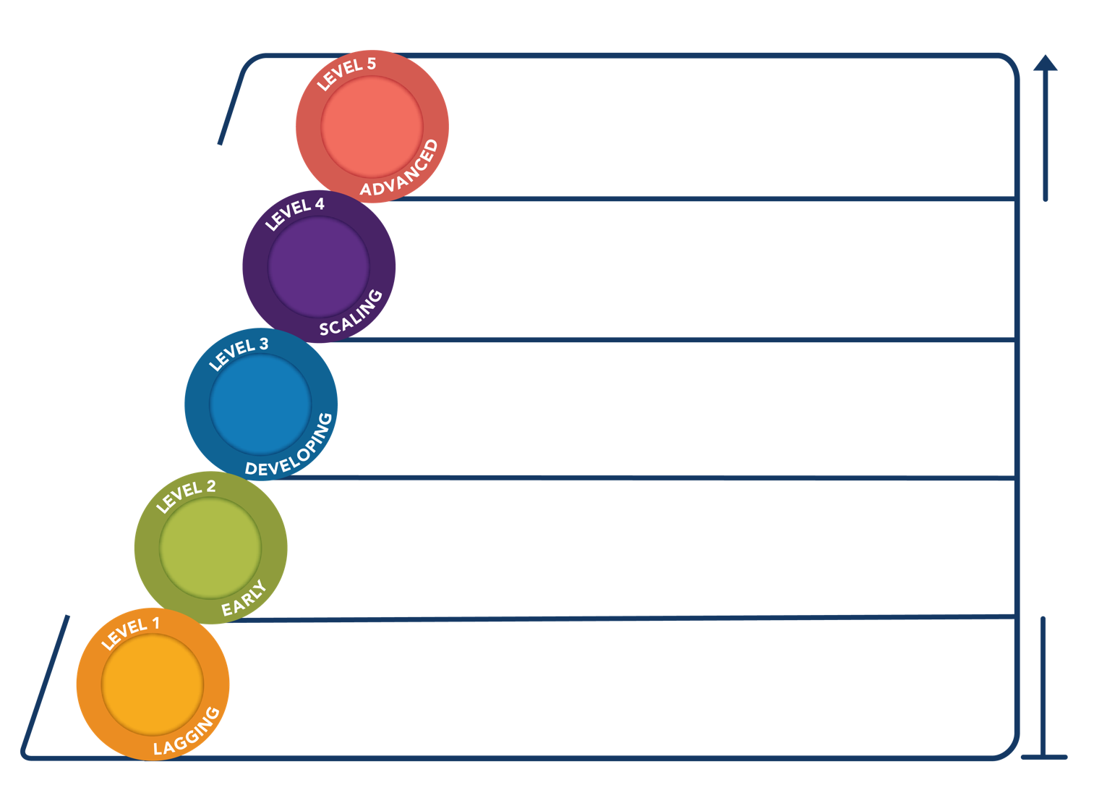
Current State of WFM Maturity
We have put in place advanced processes and technology that will help us to better understand the needs of our workforce as it relates to meeting business objectives in all areas of the organization.
10%
Direct impact on business outcomes
We have put in place advanced processes and technology that will help us to better understand the needs of our workforce as it relates to meeting business objectives in some but not all areas of the organization.
16%
Overall
Improved knowledge/ skills
34%
We are putting in place more advanced processes and technology that will help us to better understand the needs of our workforce as it relates to meeting business objectives.
Organizational Impact/ROI Curve
No impact on the business
We are beginning to evaluate how to put in place advanced processes and technology that will help us to better understand the needs of our workforce as it relates to meeting business objectives.
25%
15%
We have not evaluated how to put advanced processes and technology in place that will help us to better understand the needs of our workforce as it relates to meeting business objectives.

Slide 6
Current State of WFM Maturity
Large
What is the workforce management maturity of your organization?
LAGGING: We have not evaluated ways to put advanced processes and technology in place that will help us to better understand the needs of our workforce as it relates to meeting business objectives.
EARLY: We are beginning to evaluate ways to put advanced processes and technology in place that will help us to better understand the needs of our workforce as it relates to meeting business objectives.
DEVELOPING: We are putting more advanced processes and technology in place that will help us to better understand the needs of our workforce as it relates to meeting business objectives.
SCALING: We have put advanced processes and technology in place that will help us to better understand the needs of our workforce as it relates to meeting business objectives in some but not all areas of the organization.
ADVANCED: We have put advanced processes and technology in place that will help us to better understand the needs of our workforce as it relates to meeting business objectives in all areas of the organization.
Organizational Size: 5,000+ Employees

Slide 7
Current State of WFM Maturity
Mid-size
What is the workforce management maturity of your organization?
LAGGING: We have not evaluated ways to put advanced processes and technology in place that will help us to better understand the needs of our workforce as it relates to meeting business objectives.
EARLY: We are beginning to evaluate ways to put advanced processes and technology in place that will help us to better understand the needs of our workforce as it relates to meeting business objectives.
DEVELOPING: We are putting more advanced processes and technology in place that will help us to better understand the needs of our workforce as it relates to meeting business objectives.
SCALING: We have put advanced processes and technology in place that will help us to better understand the needs of our workforce as it relates to meeting business objectives in some but not all areas of the organization.
ADVANCED: We have put advanced processes and technology in place that will help us to better understand the needs of our workforce as it relates to meeting business objectives in all areas of the organization.
Organizational Size: 500-4,999 Employees

Slide 8
Current State of WFM Maturity
Small
What is the workforce management maturity of your organization?
LAGGING: We have not evaluated ways to put advanced processes and technology in place that will help us to better understand the needs of our workforce as it relates to meeting business objectives.
EARLY: We are beginning to evaluate ways to put advanced processes and technology in place that will help us to better understand the needs of our workforce as it relates to meeting business objectives.
DEVELOPING: We are putting more advanced processes and technology in place that will help us to better understand the needs of our workforce as it relates to meeting business objectives.
SCALING: We have put advanced processes and technology in place that will help us to better understand the needs of our workforce as it relates to meeting business objectives in some but not all areas of the organization.
ADVANCED: We have put advanced processes and technology in place that will help us to better understand the needs of our workforce as it relates to meeting business objectives in all areas of the organization.
Organizational Size: 1-499 Employees

Slide 9
Current State of WFM Maturity
Overall
13%
Critical to the business, and time and resources allocated are continually increased
7%
Not a top priority, so the needed time and resources aren’t allocated
Which best describes your organization’s current situation as it relates to supporting your WFM strategy?
26%
Important and the proper time and resources have been allocated
54%
Somewhat important but time and resources are under-allocated

Slide 10
Current State of WFM Maturity
Large
14%
Critical to the business, and time and resources allocated are continually increased
3%
Not a top priority, so the needed time and resources aren’t allocated
Which best describes your organization’s current situation as it relates to supporting your WFM strategy?
30%
Important and the proper time and resources have been allocated
54%
Somewhat important but time and resources are under-allocated
Organizational Size: 5,000+ Employees

Slide 11
Current State of WFM Maturity
Mid-size
20%
Critical to the business, and time and resources allocated are continually increased
3%
Not a top priority, so the needed time and resources aren’t allocated
Which best describes your organization’s current situation as it relates to supporting your WFM strategy?
30%
Important and the proper time and resources have been allocated
47%
Somewhat important but time and resources are under-allocated
Organizational Size: 500-4,999 Employees

Slide 12
Current State of WFM Maturity
Small
9%
Critical to the business, and time and resources allocated are continually increased
13%
Not a top priority, so the needed time and resources aren’t allocated
Which best describes your organization’s current situation as it relates to supporting your WFM strategy?
20%
Important and the proper time and resources have been allocated
59%
Somewhat important but time and resources are under-allocated
Organizational Size: 1-499 Employees

Slide 13
Complexities
There is no disputing the massive disruption to the global economy in 2020. Market volatility and shifting customer needs were identified as major areas of external influence by many organizations.
At the same time, cutting costs and building revenue were cited as the most common factors holding companies back from the inside. That shows that most organizations have not fully embraced the idea that improving workforce-management processes is a long-term strategy for success, especially when it comes to being agile enough to react to those shifting economic conditions and customer needs.

Slide 14
Challenges to WFM Maturity
Overall
What are the key external influences that impact your WFM strategy?

Slide 15
Challenges to WFM Maturity
Large
What are the key external influences that impact your WFM strategy?
Organizational Size: 5,000+ Employees

Slide 16
Challenges to WFM Maturity
Mid-size
What are the key external influences that impact your WFM strategy?
Organizational Size: 500-4,999 Employees

Slide 17
Challenges to WFM Maturity
Small
What are the key external influences that impact your WFM strategy?
Organizational Size:1-499 Employees

Slide 18
Challenges to WFM Maturity
Overall
What are the key internal influences that impact your WFM strategy?
57% | Cutting costs and reducing expenses
57% | Improving revenue
48% | Utilizing technology
47% | Employee experience
46% | Employee well-being
45% | Building a great place to work
43% | Culture
42% | Improving innovation capability
40% | Delivering new products or services
37% | Improving quality
36% | Meeting regulatory/ compliance requirements
34% | Enhancing the client/ customer/guest experience
34% | Decision-making processes
32% | Diversity and inclusion
31% | Improving brand recognition
27% | Gaining market share
26% | Expanding into new markets
15% | C-Suite perspective

Slide 19
Challenges to WFM Maturity
Large
What are the key internal influences that impact your WFM strategy?
61% | Cutting costs and reducing expenses
61% | Utilizing technology
58% | Building a great place to work
52% | Delivering new products or services
52% | Improving revenue
52% | Culture
52% | Diversity and inclusion
48% | Employee well-being
48% | Employee experience
45% | Improving innovation capability
45% | Decision-making processes
39% | Enhancing the client/ customer/guest experience
36% | Meeting regulatory/ compliance requirements
36% | Improving quality
30% | Gaining market share
30% | Expanding into new markets
27% | Improving brand recognition
12% | C-Suite perspective
Organizational Size: 5,000+ Employees

Slide 20
Challenges to WFM Maturity
Mid-size
What are the key internal influences that impact your WFM strategy?
58% | Employee well-being
58% | Employee experience
54% | Cutting costs and reducing expenses
54% | Meeting regulatory/compliance requirements
50% | Culture
46% | Improving innovation capability
46% | Utilizing technology
46% | Improving quality
38% | Delivering new products or services
38% | Improving revenue
38% | Enhancing the client/ customer/guest experience
38% | Diversity and inclusion
33% | Decision-making processes
29% | Building a great place to work
29% | Improving brand recognition
29% | C-Suite perspective
21% | Expanding into new markets
17% | Gaining market share
Organizational Size: 500-4,999 Employees

Slide 21
Challenges to WFM Maturity
Small
What are the key internal influences that impact your WFM strategy?
73% | Improving revenue
55% | Cutting costs and reducing expenses
45% | Building a great place to work
40% | Utilizing technology
40% | Employee experience
38% | Improving innovation capability
38% | Employee well-being
35% | Improving brand recognition
33% | Delivering new products or services
33% | Improving quality
33% | Culture
30% | Gaining market share
28% | Enhancing the client/ customer/guest experience
25% | Expanding into new markets
25% | Meeting regulatory/ compliance requirements
25% | Decision-making processes
13% | Diversity and inclusion
10% | C-Suite perspective
Organizational Size: 1-499 Employees

Slide 22
Consequences
As shown, workforce management has not been fully accepted as a driver for change, but part of the reason is how “success” is assessed. Most organizations view employee engagement and retention as measures of success instead of linking WFM directly to productivity or revenue, upon which workforce management clearly has an impact.
Less than 10% of organizations see workforce management as something that drives maximum revenue and profitability gains. This is not to say that employee experience and EVP aren’t important; they are, but the final step is linking those metrics to your ultimate business goals.

Slide 23
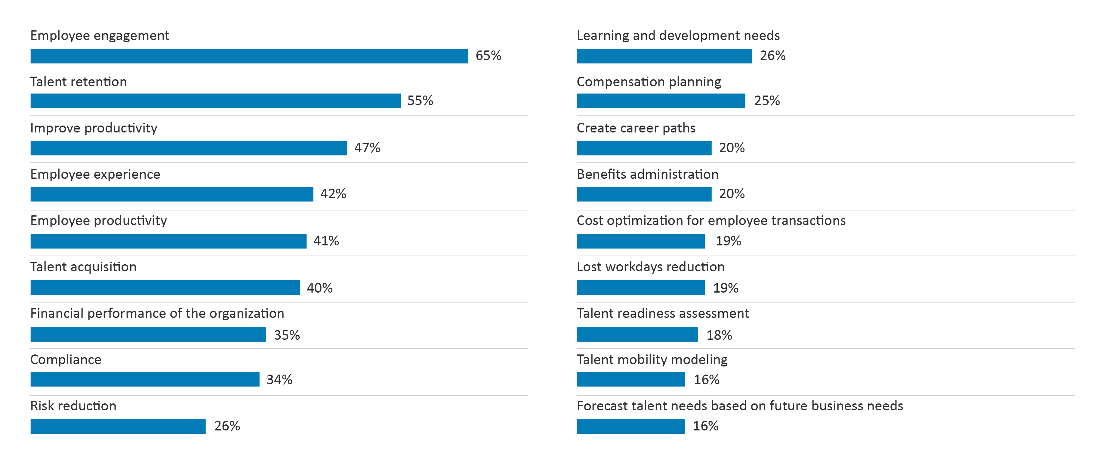
Impact to WFM Maturity
Overall
What KPIs do you use to measure the effectiveness of your WFM strategy?

Slide 24
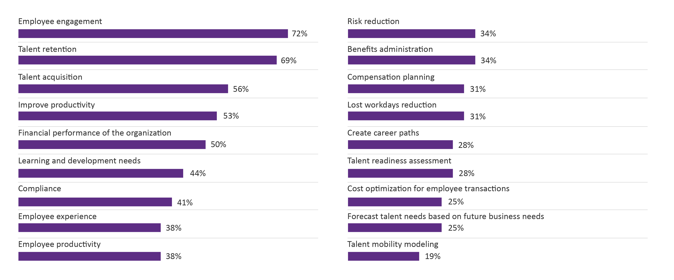
Impact to WFM Maturity
Large
What KPIs do you use to measure the effectiveness of your WFM strategy?
Organizational Size: 5,000+ Employees

Slide 25
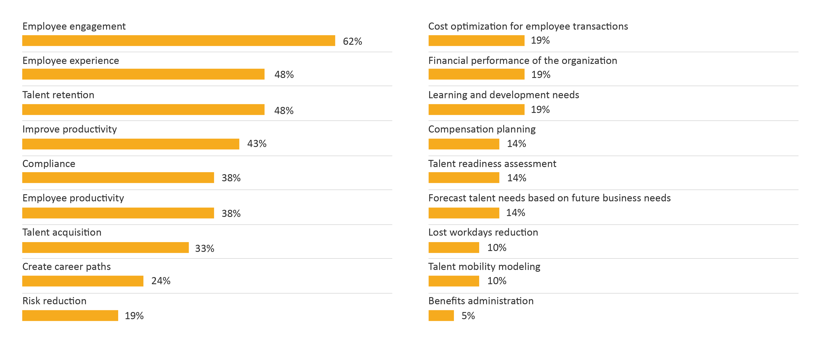
Impact to WFM Maturity
Mid-size
What KPIs do you use to measure the effectiveness of your WFM strategy?
Organizational Size: 500-4,999 Employees

Slide 26
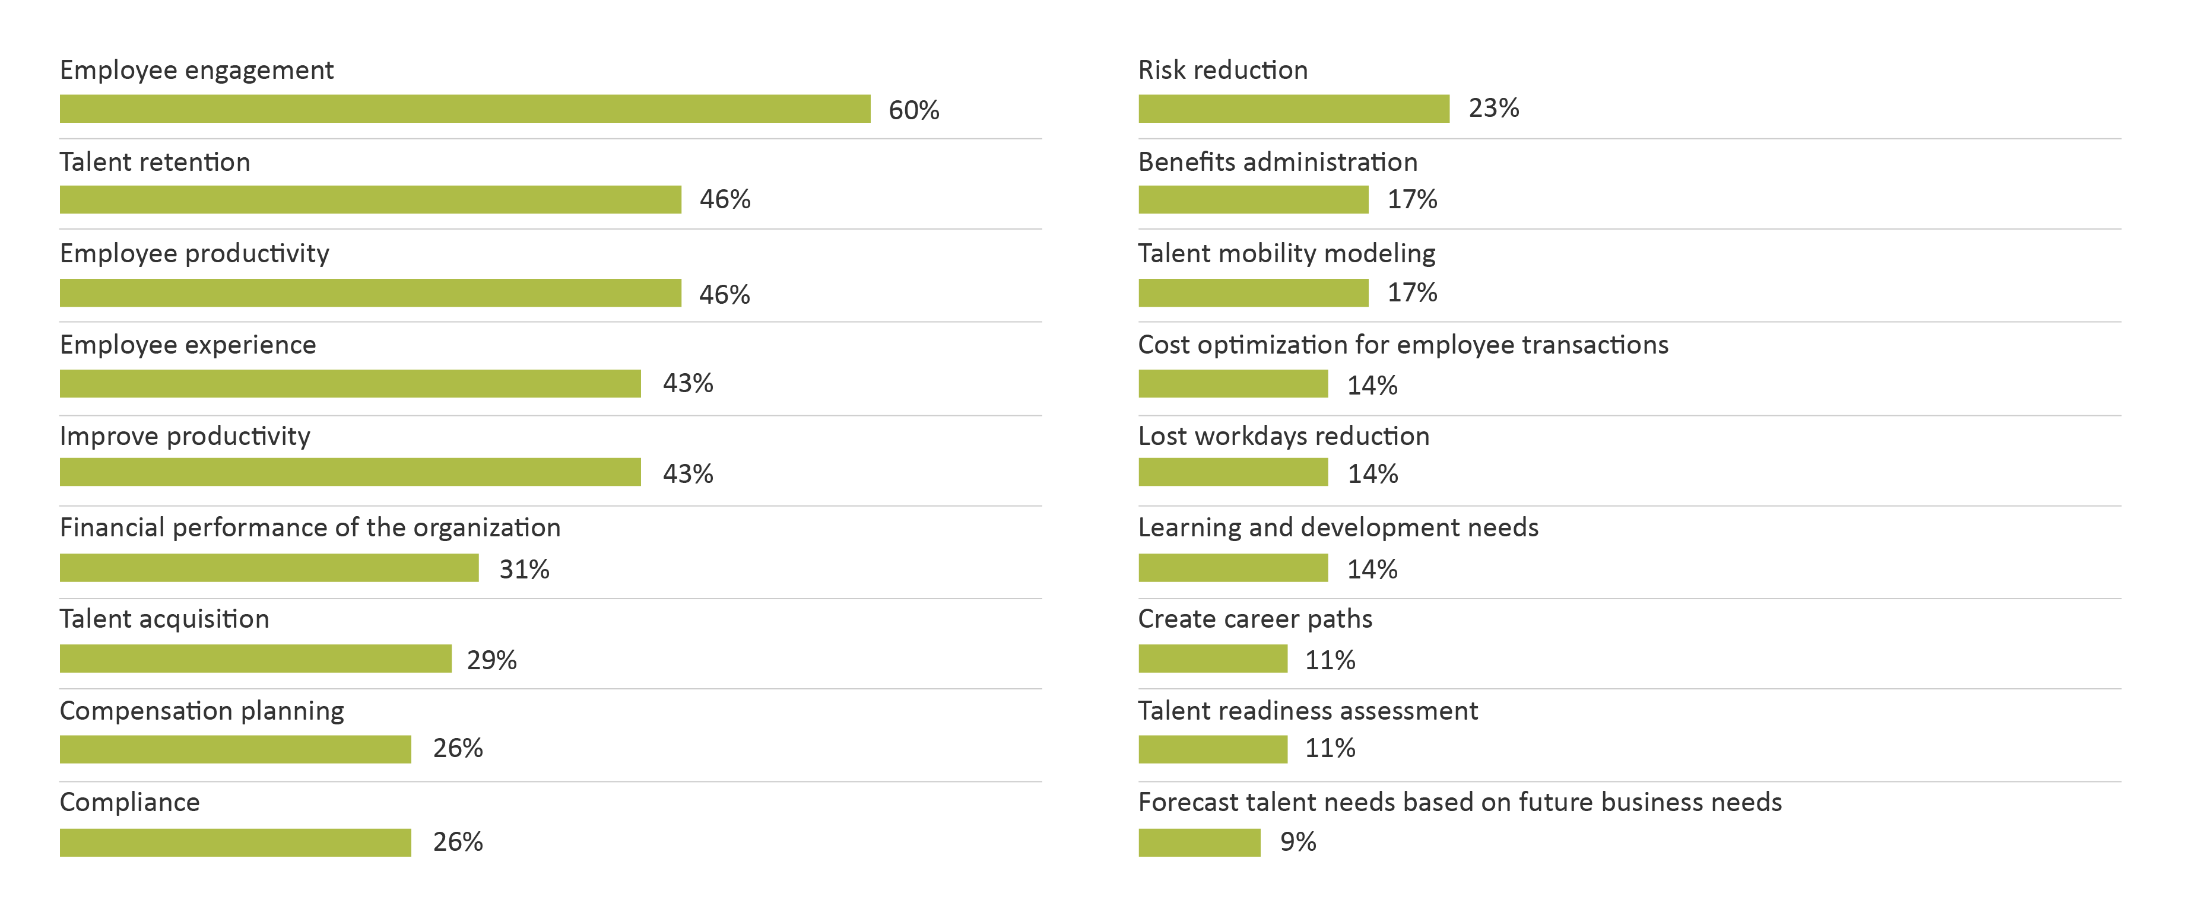
Impact to WFM Maturity
Small
What KPIs do you use to measure the effectiveness of your WFM strategy?
Organizational Size: 1-499 Employees

Slide 27
Impact to WFM Maturity
Overall
14%
We don’t have a vision for WFM.
17%
Our vision for WFM is to improve the employee experience and strengthen our Employee Value Proposition.
Which best describes your vision for WFM in your organization?
17%
Our vision for WFM is to make sure everyone comes to work and is highly productive.
8%
Our vision for WFM is to have people drive maximum revenue and profitability gains.
44%
Our vision for WFM is to make sure we have the right talent in the right place to meet our business objectives.

Slide 28
Impact to WFM Maturity
Large
6%
We don’t have a vision for WFM.
26%
Our vision for WFM is to improve the employee experience and strengthen our Employee Value Proposition.
3%
Our vision for WFM is to make sure everyone comes to work and is highly productive.
Which best describes your vision for WFM in your organization?
53%
Our vision for WFM is to make sure we have the right talent in the right place to meet our business objectives.
12%
Our vision for WFM is to have people drive maximum revenue and profitability gains.
Organizational Size: 5,000+ Employees

Slide 29
Impact to WFM Maturity
Mid-size
7%
We don’t have a vision for WFM.
18%
Our vision for WFM is to improve the employee experience and strengthen our Employee Value Proposition.
Which best describes your vision for WFM in your organization?
 | Responses
We don’t have a vision for WFM. | 7%
Our vision for WFM is to make sure everyone comes to work and is highly productive. | 18%
Our vision for WFM is to make sure we have the right talent in the right place to meet our business objectives. | 50%
Our vision for WFM is to have people drive maximum revenue and profitability gains. | 7%
Our vision for WFM is to improve the employee experience and strengthen our Employee Value Proposition. | 18%
Which best describes your vision for WFM in your organization?
7%
Our vision for WFM is to have people drive maximum revenue and profitability gains.
18%
Our vision for WFM is to make sure everyone comes to work and is highly productive.
50%
Our vision for WFM is to make sure we have the right talent in the right place to meet our business objectives.
Organizational Size: 500-4,999 Employees

Slide 30
Impact to WFM Maturity
Small
26%
We don’t have a vision for WFM
9%
Our vision for WFM is to improve the employee experience and strengthen our Employee Value Proposition.
Which best describes your vision for WFM in your organization?
5%
Our vision for WFM is to have people drive maximum revenue and profitability gains.
28%
Our vision for WFM is to make sure everyone comes to work and is highly productive.
33%
Our vision for WFM is to make sure we have the right talent in the right place to meet our business objectives.
Organizational Size: 1-499 Employees

Slide 31
Critical Questions
As organizations consider their Workforce Management strategy, they must answer several critical questions, including:
What are the most important elements of your WFM strategy?
What role does executive management play in WFM strategy?
Who is accountable for the success of WFM in your organization?
What are the key metrics and data that should be collected and analyzed for successful WFM?
What is the type of team that will work best for managing your workforce strategy?

Slide 32
Brandon Hall Group Point of View
Five High-Level Strategies to Improve WFM Maturity
1
2
There is more to WFM than reducing risk — think five years ahead.
There is no doubt that reducing risk and ensuring regulatory compliance are important, but that is not a long-term strategy for success in WFM management. Improving productivity and the employee experience, and aligning workforce goals with business goals, are the ultimate guards against future volatility or other directional changes.
Workforce Management is a collaborative effort, not an HR activity.
Organizations seem split between having WFM strategy come from HR and then communicated to executive stakeholders or the other way around (although most favor the HR-developed model). However, a truly successful WFM strategy is developed collaboratively among HR and the business lines of they support, with executives providing oversight to the process. Brandon Hall Group research shows that this creates the alignment between WFM goals and overall business goals that are often the missing links to success.

Slide 33
Brandon Hall Group Point of View
Five High-Level Strategies to Improve WFM Maturity
3
4
5
WFM data should come from a wide variety of sources.
There are far too many organizations looking at metrics such as risk reduction, compliance and lost workdays as the sole data to determine the effectiveness of their WFM program.
Successful organizations widen the net, looking at employee engagement, employee experience, talent retention, productivity and career-pathing opportunities as key performance indicators.
Review your current technology for scalability.
Workforce-management technology has improved leaps and bounds over where it was from just 10 years ago. The ability to integrate and gather data from other sources (Strategy 3) is only available if your system allows it. Along with that, the ability to customize, personalize and provide self-service to an ever-increasing remote workforce is only scalable if your technology supports those functions. These are processes that cannot be done manually.
Rather than trying to anticipate challenges, build a workforce that’s ready for anything.
After an especially unstable period during last few years, it is understandable that many organizations are investing in predictive models, trying to see what may happen next so they can plan their WFM strategy accordingly.
Unfortunately, this is the wrong strategy. Instead, develop a workforce-management team that will be able to deploy strategies that will answer any questions the future may ask of your organization.

Slide 34
Contributors
Cliff Stevenson, Principal Workforce Management Analyst
Cliff Stevenson is the Principal Analyst for Workforce Management and Talent Acquisition at Brandon Hall Group. Before joining Brandon Hall Group, he was the HR leader for a Boston consulting firm. Cliff received his Master's degree in Organizational Development from Suffolk University and Bachelor's degree in Psychology from the University of South Florida.
Mike Cooke, Chief Executive Officer and Principal HCM Analyst
Prior to joining Brandon Hall Group, Mike was the Chief Executive Officer and Co-founder of AC Growth. Mike has held leadership and executive positions for the majority of his career, responsible for steering sales and marketing teams to drive results and profitability. His background includes more than 15 years of experience in sales and marketing, management, and operations in the research, consulting, software and technology industries.
Michael Rochelle, Chief Strategy Officer and Principal HCM Analyst
Prior to joining Brandon Hall Group, Michael was the Chief Strategy Officer and Co-founder at AC Growth. Michael serves in a variety of roles including overseeing consulting and advisory support for corporations and solution providers. Michael has led a wide range of advisory support and strategic engagements for Fortune 1000 and small- to medium-sized organizations as well as leading and emerging solution providers across the HCM industry. Michael is one of the company’s principal analysts covering the learning and development, talent management, leadership development, workforce management and talent acquisition sectors. Michael also leads the analyst coverage for solution providers in these sectors.
Richard Pachter, Content Manager
Richard Pachter edited this report. He is the Content Manager at Brandon Hall Group and is responsible for editing content. He has experience as a journalist, copywriter, editor, marketer, blogger and social media marketing manager.
Emma Bui, Graphic Design Associate
Emma Bui created the graphics and layout for this report.

Slide 35
About Brandon Hall Group
With more than 10,000 clients globally and 27 years of delivering world-class research and advisory services, Brandon Hall Group is focused on developing research that drives performance in emerging and large organizations and provides strategic insights for executives and practitioners responsible for growth and business results.
Some ways we can help …
MEMBERSHIP PACKAGE
ADVISORY OFFERINGS
EXCELLENCE AWARDS
PROFESSIONAL DEVELOPMENT
Includes research library access, events, advisory support, a client success plan and more.
An array of benchmarking, strategy, technology selection, and integration.
Global recognition showcasing leading programs and practices with a library of case studies.
Virtual and on-site certification programs supplemented with research-driven assessments and tools.
ORGANIZATIONAL EXCELLENCE CERTIFICATION PROGRAM recognizes world-class HCM programs that transform their organization and achieve breakthrough results.
SMARTCHOICE® PREFERRED PROVIDER PROGRAM uniquely places HCM service and technology companies at the top of organizations’ consideration list of vendors.
HCMA PROFESSIONAL CERTIFICATIONS are comprehensive educational programs that center around a multiphase knowledge test.

