Slide 1
Developing
Inclusive Leaders
Research Data Highlights
2022
© Brandon Hall Group 2022. Not for distribution.

Slide 2

Introduction
This presentation provides an overview of Brandon Hall Group’s study, How Do You Develop Inclusive Leaders? conducted in October 2022.
It is meant as a targeted survey, conducted over a few days, to understand employers’ approach to developing inclusive leaders.
This deck provides the data breakdowns for the entire survey pool.

Slide 3

Current State
  About half of organizations believe inclusive leadership is critical or important and about the same percentage believe their leaders demonstrate inclusive leadership behaviors to a high degree.
  More than 80% of survey respondents indicated that leaders from the frontline to the C-suite receive some sort of learning experience around inclusive leadership.
  Together, this data suggests that inclusive leadership is more accepted than it was in previous years when we asked these same questions. In 2020 less than half of organizations surveyed were providing training specifically on inclusive leadership.

Slide 4
Current State
Importance of Developing Inclusive Leaders
Critical/Important | 52%
52%
Importance of Developing Inclusive Leaders
(Critically/important)
50%
Leaders Demonstrate Traits of Inclusive Leadership to
High Degree
42%
Leadership Development Approach Includes Experiences Specifically on Inclusive Leaders
Leaders Demonstrate Traits of Inclusive Leadership to High Degree
50%
Leadership Development Approach Includes Experiences Specifically on Inclusive Leaders
42%

Slide 5
Who Receives Development Experiences on Inclusive Leadership
Senior leaders
(director and above)
Executives (C-suite)
Mid-level managers
Frontline managers
Individual contributors

Slide 6





Effectiveness of Inclusive Leadership Training
6%
6%
38%
37%
13%
1
2
3
4
5
Not at all effective
Extremely effective

Slide 7




Complexities
  Everyone, even those who may not have formal leadership roles now, can benefit from the principles of inclusive leadership.
  Among the traits and behaviors that organizations said they address in inclusive leadership training, some of the most powerful inclusion drivers get the least attention. For example, only 18% of organizations indicated thy focus on reverse mentoring, which can be extremely effective in exposing leaders to different viewpoints and help them be more inclusive. Many leaders – especially those at higher levels or with mature careers – can benefit by getting a deeper understanding of the values, beliefs, motivations and capabilities of the emerging workforce.
  Just 34% of organizations are focusing on inclusive decision-making, which is really the heart and soul of inclusive leadership. If teams believe they have a real role in making decisions, they will be more engaged and feel a greater connection with the organization.
  In previous research, about 70% of organizations indicated all employees – including individual contributors – should get some sort of leadership training.
  In this study, 53% of organizations said individual contributors were provided specific experiences on inclusive leadership. So this is an area of opportunity for many organizations to further build a culture of inclusive leadership.

Slide 8
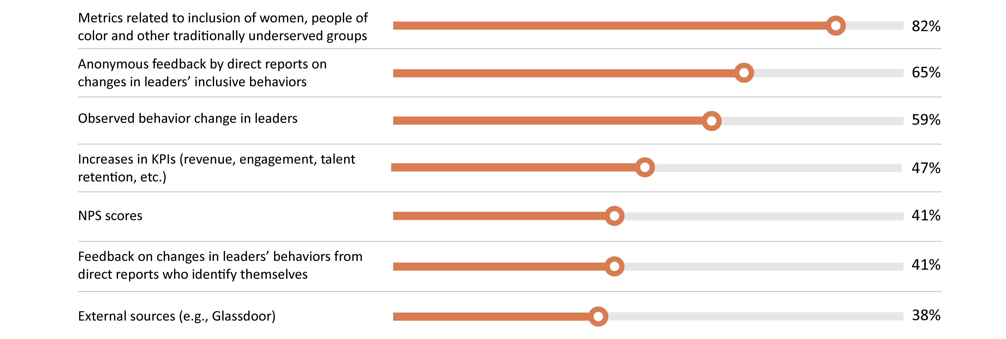
How Effectiveness of Inclusive Leadership Training is Assessed

Slide 9

Inclusive Leader Traits Addressed in Leadership Development Programs
60%
Action-oriented
59%
Collaborative
58%
Emotional
intelligence
55%
Self-aware
53%
Awareness of
unconscious bias
52%
Accountable
49%
Adaptable
47%
Learning-focused
45%
Empathetic
45%
Motivating
42%
Authentic
37%
Cultural
intelligence
37%
Mitigation of
unconscious bias
34%
Inclusive
communication
26%
Courageous

Slide 10
Inclusive Leadership Behaviors Addressed in Leadership Programs
71%
65%
65%
65%
62%
59%
59%
Coaching
Change management
Leading remote and hybrid workers
Providing constructive feedback
Building interpersonal trust
Building an environment of psychological safety
Recruiting, interviewing and hiring diverse candidates
57%
56%
50%
41%
34%
29%
18%
Managing conflict and difficult conversations
Recognizing the contributions of everyone
Allyship (intentional, positive conscious efforts to advance the culture of inclusion)
Mentoring
Facilitating inclusive decision-making
Leading during disruption
Reverse mentoring

Slide 11
Organizations That Educate Leaders on Issues Impacting Traditionally Under-Represented and Excluded Groups
People with disabilities
People with color
Women
Age
LGBTQIA+
Veterans
Economically disadvantaged
Religion/faith

Slide 12

Consequences
  It is difficult to get too excited about the rise of inclusive leadership when, in 57% of organizations, less than one-fifth of high-level leaders are from diverse and traditionally under-represented groups.
  In addition, when measuring the inclusion of under-represented groups, most organizations focus on measuring demographic diversity rather equity in engagement scores performance ratings, recognition, participation in cross-functional team projects, or participation in various forms of training.
  The success of inclusive leadership depends on expanding inclusion across the enterprise. While that may be happening in some organizations, it is important to measure specific outcomes of inclusion to see where you are and where progress is still needed.
  Real inclusion also is not possible without fully embedding the principles of inclusion across the enterprise in many ways.
  Two-thirds of organizations embed the principles of inclusion into their vision and mission statements, which is good, but less than half do so with their career development and succession policies and only 30% do so with compensation policies.

Slide 13
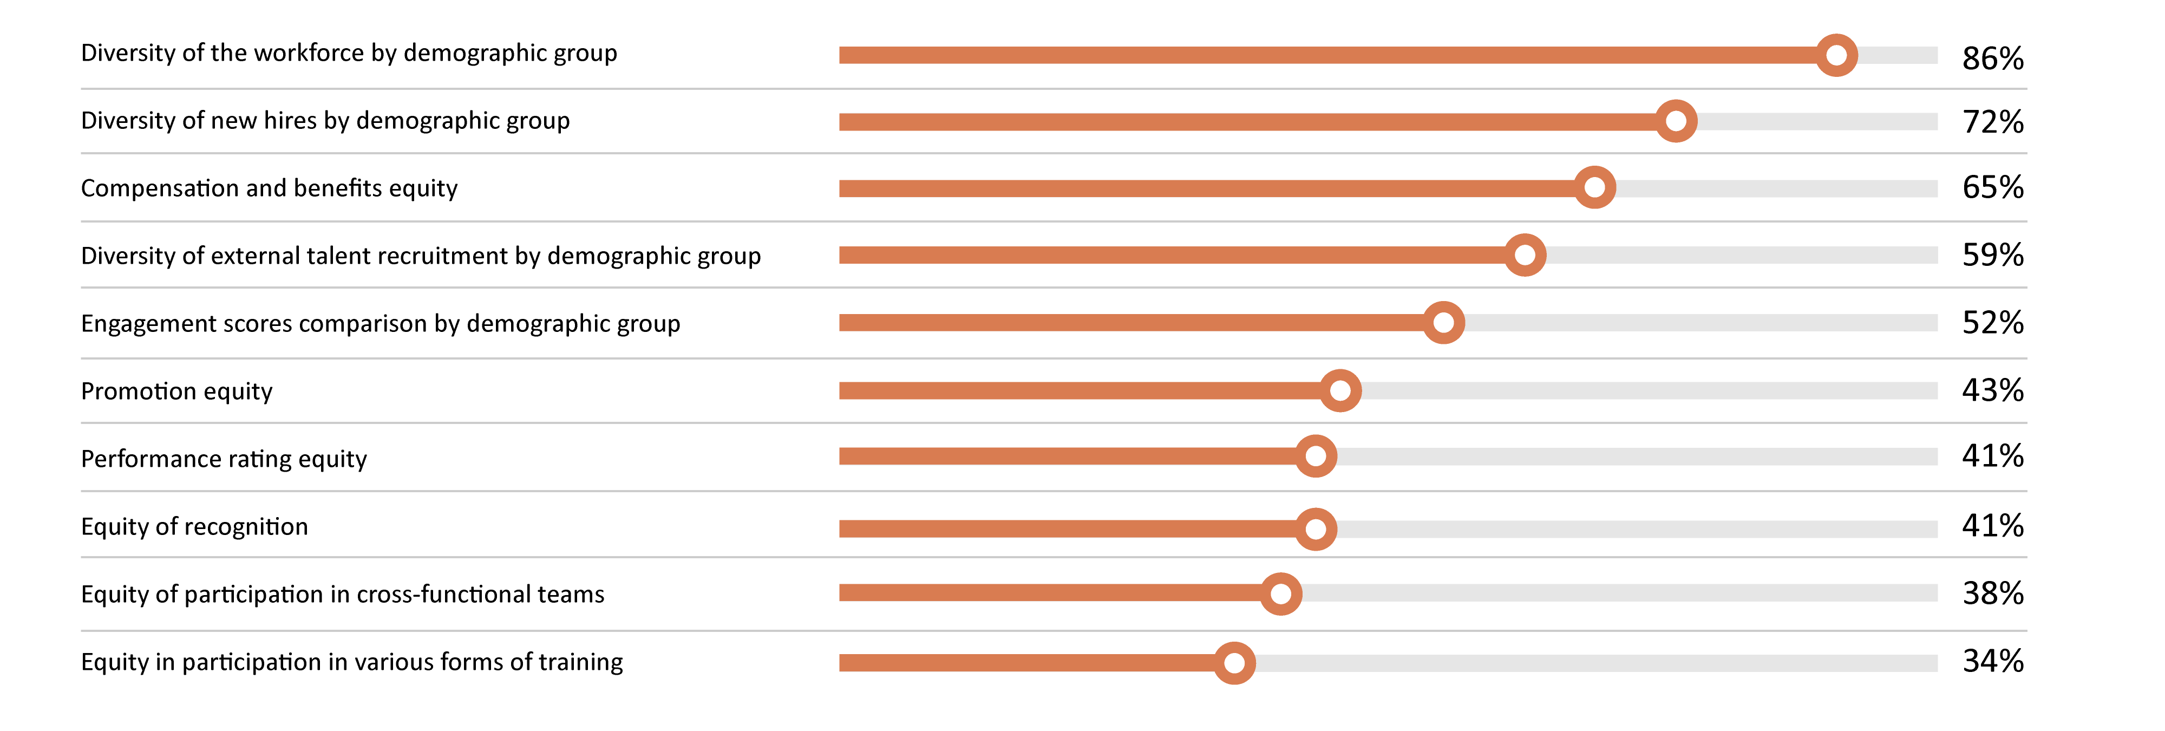
Metrics Used to Evaluate Inclusion of Women, People of Color and Other Traditionally Under-Represented Groups

Slide 14
How Inclusive Leadership Principles are Embedded in Business Practices
68%
60%
59%
59%
57%
Vision and mission statements
Recruitment and hiring policies
Learning initiatives
Onboarding
DE&I organization-wide strategic plan
51%
43%
35%
32%
30%
Annual business objectives/plans
Career development and succession practices
Supplier and vendor selection
Performance evaluations
Compensation policies
Principles | Percentage of organizations
Vision and mission statements | 68%
Recruitment and hiring policies | 60%
Learning initiatives | 59%
Onboarding | 59%
DE&I organization-wide strategic plan | 57%
Annual business objectives/plans | 51%
Career development and succession practices | 43%
Supplier and vendor selection | 35%
Performance evaluations | 32%
Compensation policies | 30%

Slide 15
Representation of Leaders, VP and Above, from Diverse Groups (Women, People of Color, People with Disabilities, etc.)
29%
28%
25%
9%
9%
10% and less
11-20%
21-30%
31-40%
More than 40%
Range | Percentage of organizations
10% and less | 29%
11-20% | 28%
21-30% | 25%
31-40% | 9%
More than 40% | 9%

Slide 16
Critical Questions
Organizations that want to develop more inclusive leaders as a strategy toward becoming a more diverse, equitable and inclusive organization must consider several questions. They include:
What are our greatest barriers to having a more inclusive culture?
Do our leaders consistently demonstrate the values of our organization?
Do we have leaders with the interest and ability to truly tap into the talents and motivations of their teams to collaborate, empower and inspire rather than wield their authority?
Do we have leaders who consistently demonstrate their commitment to diversity, equity and inclusion and will challenge the status quo when necessary?
Do we have leaders who actively seek to understand those around them — including people from different cultures and backgrounds — and listen, empathize and adapt to their points of view?
Are there particular strategies or behaviors that are in the most serious need of attention?
How can we make inclusive leadership and diversity, equity and inclusion a bigger priority without sacrificing other business goals?

Slide 17
Brandon Hall Group Point of View
  From our research, Brandon Hall Group developed recommendations to help organizations improve. Here are five high-level strategies to consider regarding inclusive leadership:
1
2
3
  Understand the greatest barriers to inclusive leadership. Actively listen to all diverse groups within your organization.
  Commit to training on inclusive leadership at all levels of the organization. Prioritize training based on the greatest need.
  Create or strengthen ownership. Inclusion is a business imperative, so it needs top leaders to own it and drive accountability.
4
5
  Create or strengthen your Diversity Council and Employee Resource Groups. Involvement and activism across the organization builds a culture of inclusion.
  Measure inclusively. Assess everything from compensation to recognition and participation in training and cross-function teams.

Slide 18
Contributors
Claude Werder, Senior VP and Principal HCM Analyst
Claude Werder wrote this report. He runs Brandon Hall Group’s Talent Management, Leadership Development and DE&I practices, focusing on solving corporate’s challenges in developing and retaining talent. He takes a strategic, unified approach, with a keen eye on leveraging technology to drive efficiencies that enable leaders to better engage employees and drive performance.
Michael Rochelle, Chief Strategy Officer
and Principal HCM Analyst
Prior to joining Brandon Hall Group, Michael was the Chief Strategy Officer and co-founder at AC Growth. Michael serves in a variety of roles including overseeing consulting and advisory support for corporations and solution providers. Michael has led a wide range of advisory support and strategic engagements for Fortune 1000 and small- to medium-sized organizations as well as leading and emerging solution providers across the HCM industry. Michael is one of the company’s principal analysts covering the learning and development, talent management, leadership development, workforce management and talent acquisition sectors. Michael also leads the analyst coverage for solution providers in these sectors.
Mike Cooke, Chief Executive Officer
and Principal HCM Analyst
Prior to joining Brandon Hall Group, Mike was the Chief Executive Officer and Co-founder of AC Growth. Mike has held leadership and executive positions for the majority of his career, responsible for steering sales and marketing teams to drive results and profitability. His background includes more than 15 years of experience in sales and marketing, management, and operations in the research, consulting, software and technology industries.
Richard Pachter, Content Manager
Richard Pachter edited this report. He is the Content Manager at Brandon Hall Group and is responsible for editing all research assets and other content. He has experience as a journalist, copywriter, editor, marketer, blogger and social media marketing manager.
Rachel Cooke, Chief Operating Officer
and Principal HCM Analyst
She is responsible for business operations, including client and member advisory services, marketing design, annual awards programs, conferences and the company’s project management functions. She also leads Advancing Women in the Workplace and Diversity, Equity and Inclusion initiatives, research and events. Rachel worked in the HCM research industry for 15 years and held several key management and executive positions within the Talent and Learning Research, and Performance Improvement industries.
Emma Bui, Graphic Design Associate
Emma Bui created the graphics and layout for this report.

Slide 19
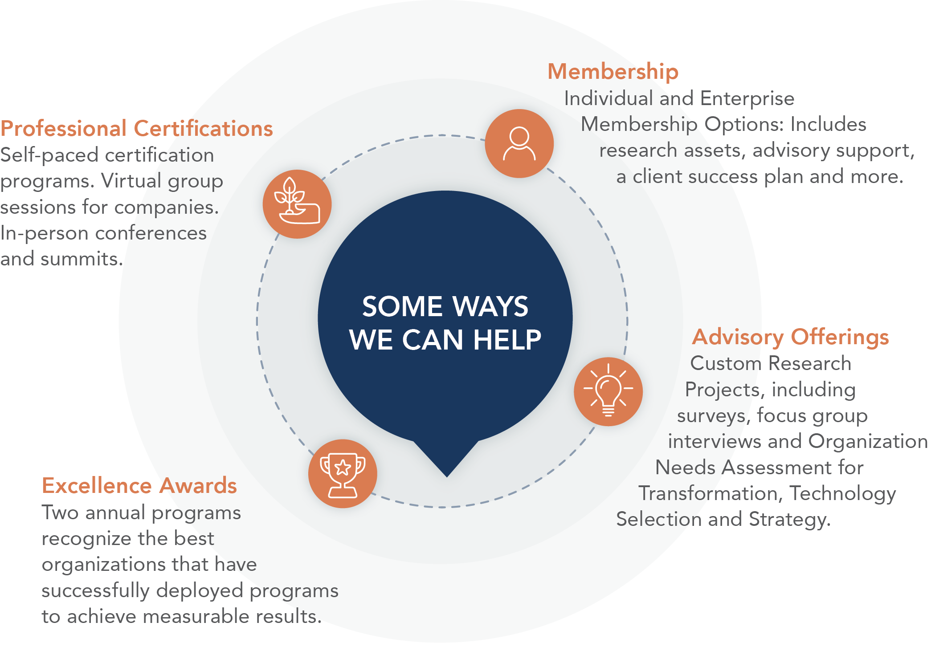
About
Brandon Hall Group
With more than 10,000 clients globally and 28 years of delivering world-class research and advisory services, Brandon Hall Group is focused on developing research that drives performance in emerging and large organizations and provides strategic insights for executives and practitioners responsible for growth
and business results.
ORGANIZATIONAL EXCELLENCE CERTIFICATION PROGRAM
recognizes world-class HCM programs that transform their organization and achieve breakthrough results. This designation is the next step beyond the HCM Excellence Awards, which focus on a single program, and looks at the department as a whole.
SMARTCHOICE® PREFERRED PROVIDER PROGRAM
uniquely places HCM service and technology companies at the top of organizations’ consideration list of vendors. It adds an unmatched level of credibility based on BHG’s quarter-of-a-century of experience in evaluating and selecting the best solution providers for leading organizations around the world.

