Slide 1
Extended Enterprise Learning
Research Data Highlights
2022
© Brandon Hall Group 2022. Not for distribution.

Slide 2

Introduction
This presentation provides an overview of Brandon Hall Group’s Extended Enterprise Learning survey, conducted in November 2022. It includes a look at how companies approach learning for various external audiences, including the strategies and tools they use to meet the challenges inherent in this kind of environment. It includes analysis, critical questions organizations must answer, and Brandon Hall Group’s point of view on the research.

Slide 3

Current State
The number of companies that find it necessary or beneficial to deliver training to external audiences such as customers, channel partners, distributors, resellers, and franchisees continues to grow, making the extended enterprise a critical segment of the L&D universe.
Brandon Hall Group’s 2022 Extended Enterprise Learning Study finds that nearly two-thirds of organizations deliver learning to at least one external, non-employee group.

Slide 4
To which of the following audiences does your organization provide learning/training?

Slide 5
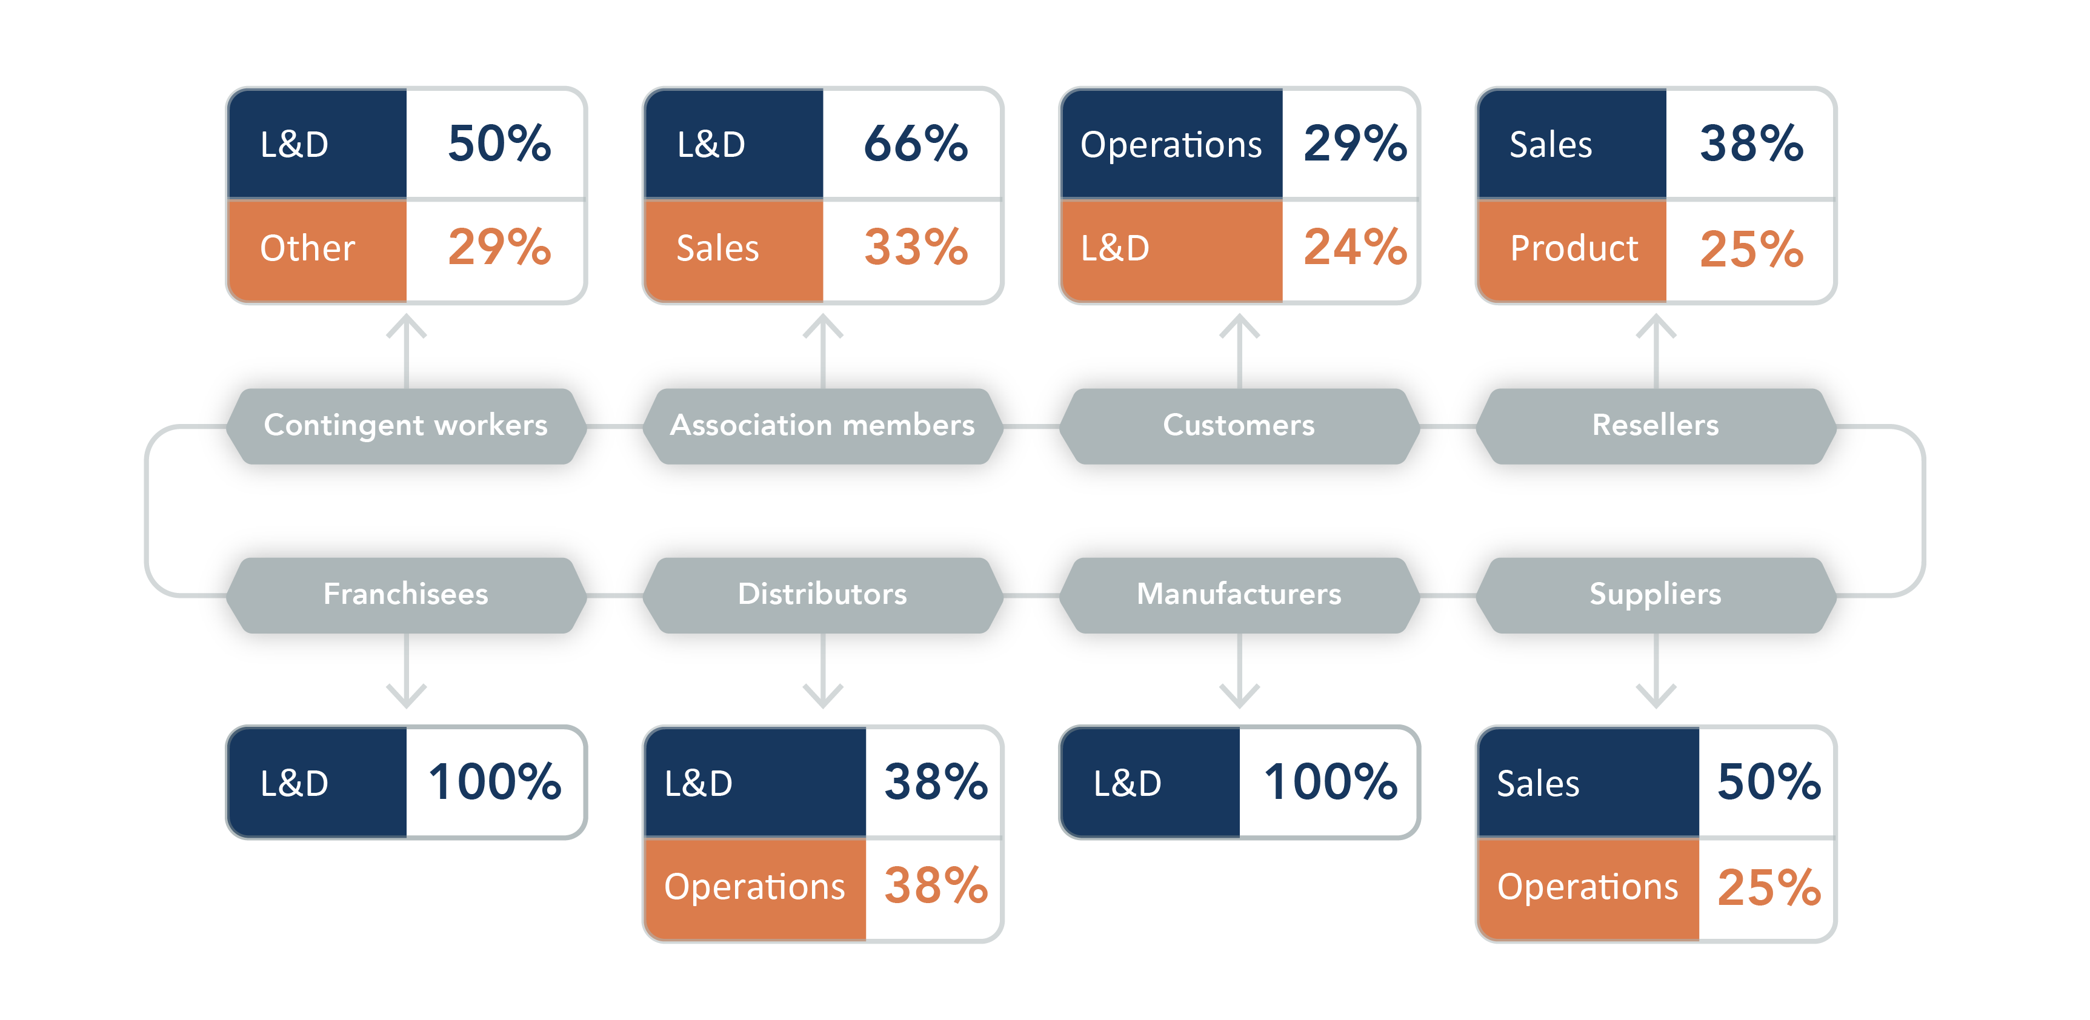
Which group has primary ownership of Learning for each of the following?

Slide 6
Which of the following are objectives of your organization's extended learning?

Slide 7

Complexities
Creating, delivering, and measuring learning for an organization’s workforce is a complex undertaking for most L&D teams. However, the challenges and complexity grow exponentially when the learning audience is made up of disparate groups of people that are not employees.
A lack of insight into these audiences makes it difficult for a company to measure the effectiveness of its efforts. Additionally, companies sometimes find themselves lacking the right technology to execute an extended enterprise strategy, relying instead on platforms and solutions that may have not been designed for this purpose.

Slide 8
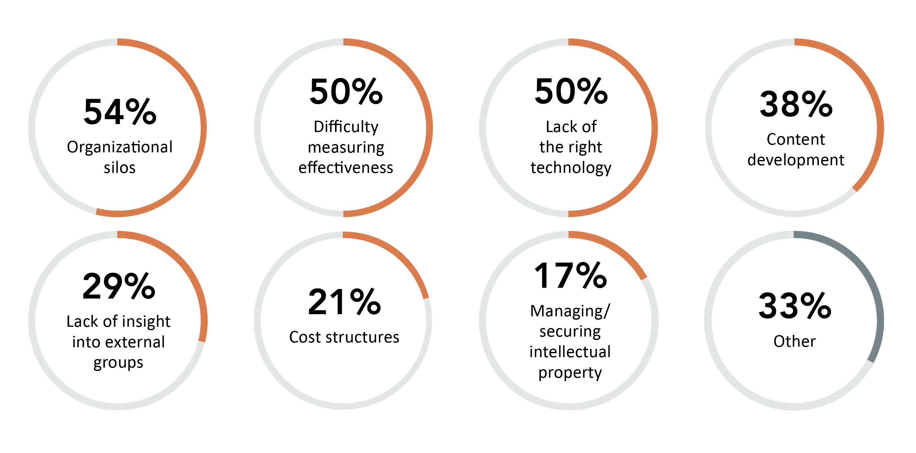
Which of the following are challenges to delivering extended enterprise learning?

Slide 9
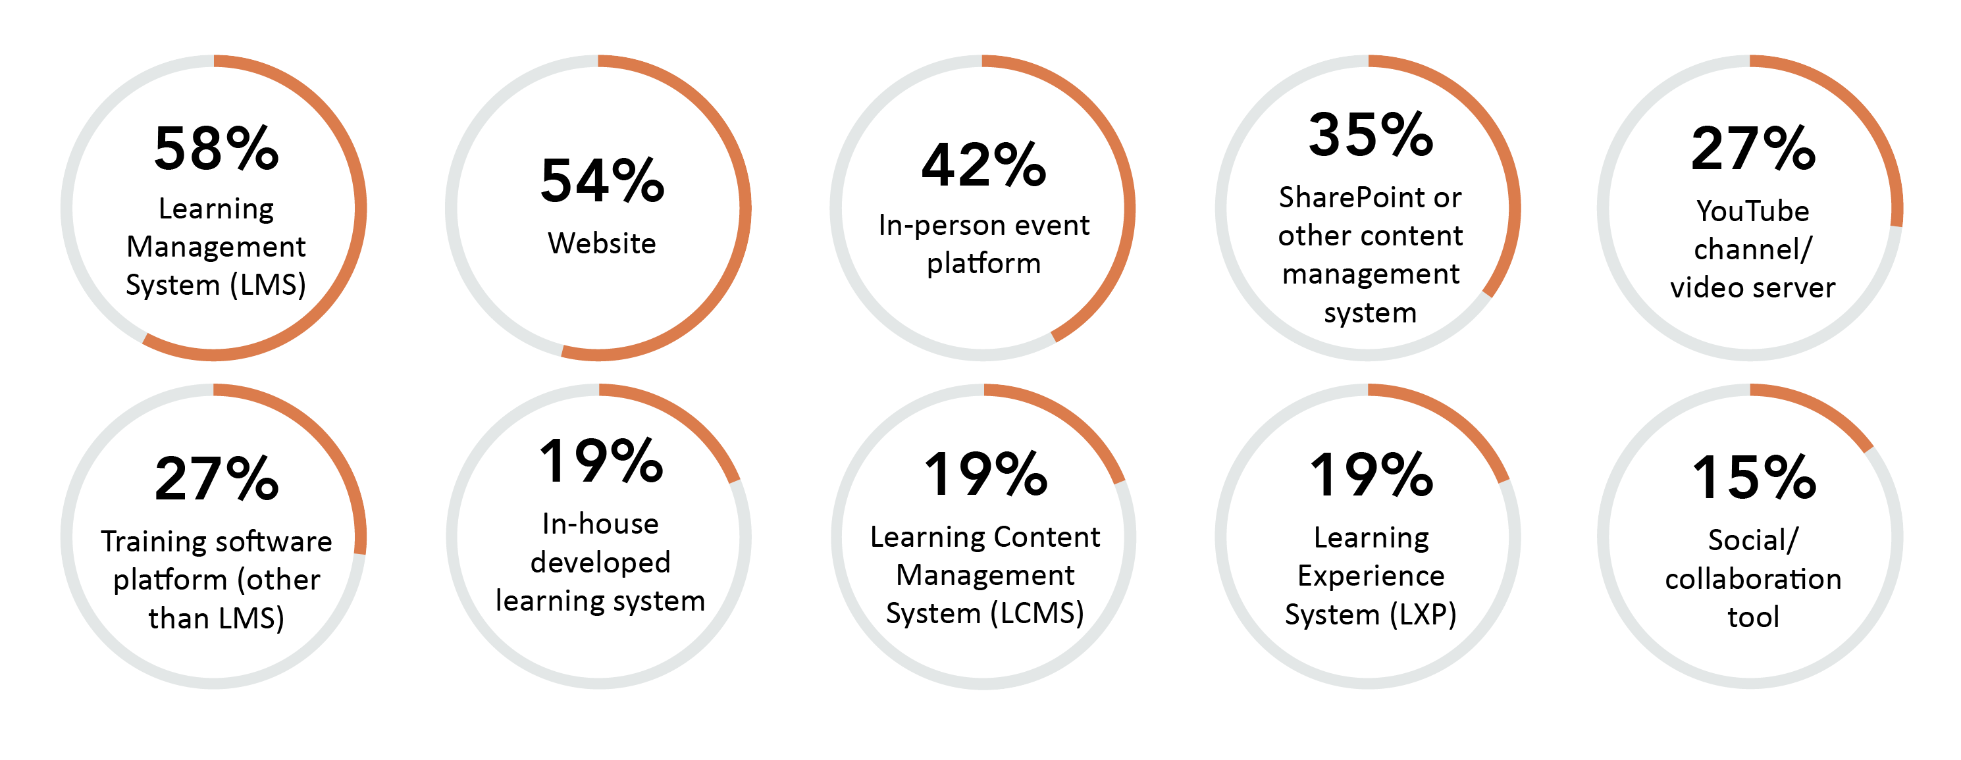
Which of the following systems does your organization use to deliver extended enterprise learning?

Slide 10

Which of the following methods does your organization use to deliver extended learning?
73%
Meeting tool (Zoom, Teams, etc.)
35%
Microlearning
65%
In-person
35%
Printed material
62%
Videos
23%
Games/simulations
54%
eLearning course modules
12%
Mobile content
50%
Virtual classrooms
8%
Virtual reality
38%
Webinar platform

Slide 11

Which technology characteristics are important to support extended enterprise learning?
65%
Reporting and analytics
48%
Data security protocols
63%
Testing/assessment
48%
Social platform
52%
35%
e-Commerce functionality
Branded experience
48%
Custom admin levels/permission
17%
Artificial intelligence
48%
Ability to set up multiple portals/ domains
17%
Gamification
48%
13%
Offline player for accessing courses
Certification
48%
Mobile capabilities

Slide 12
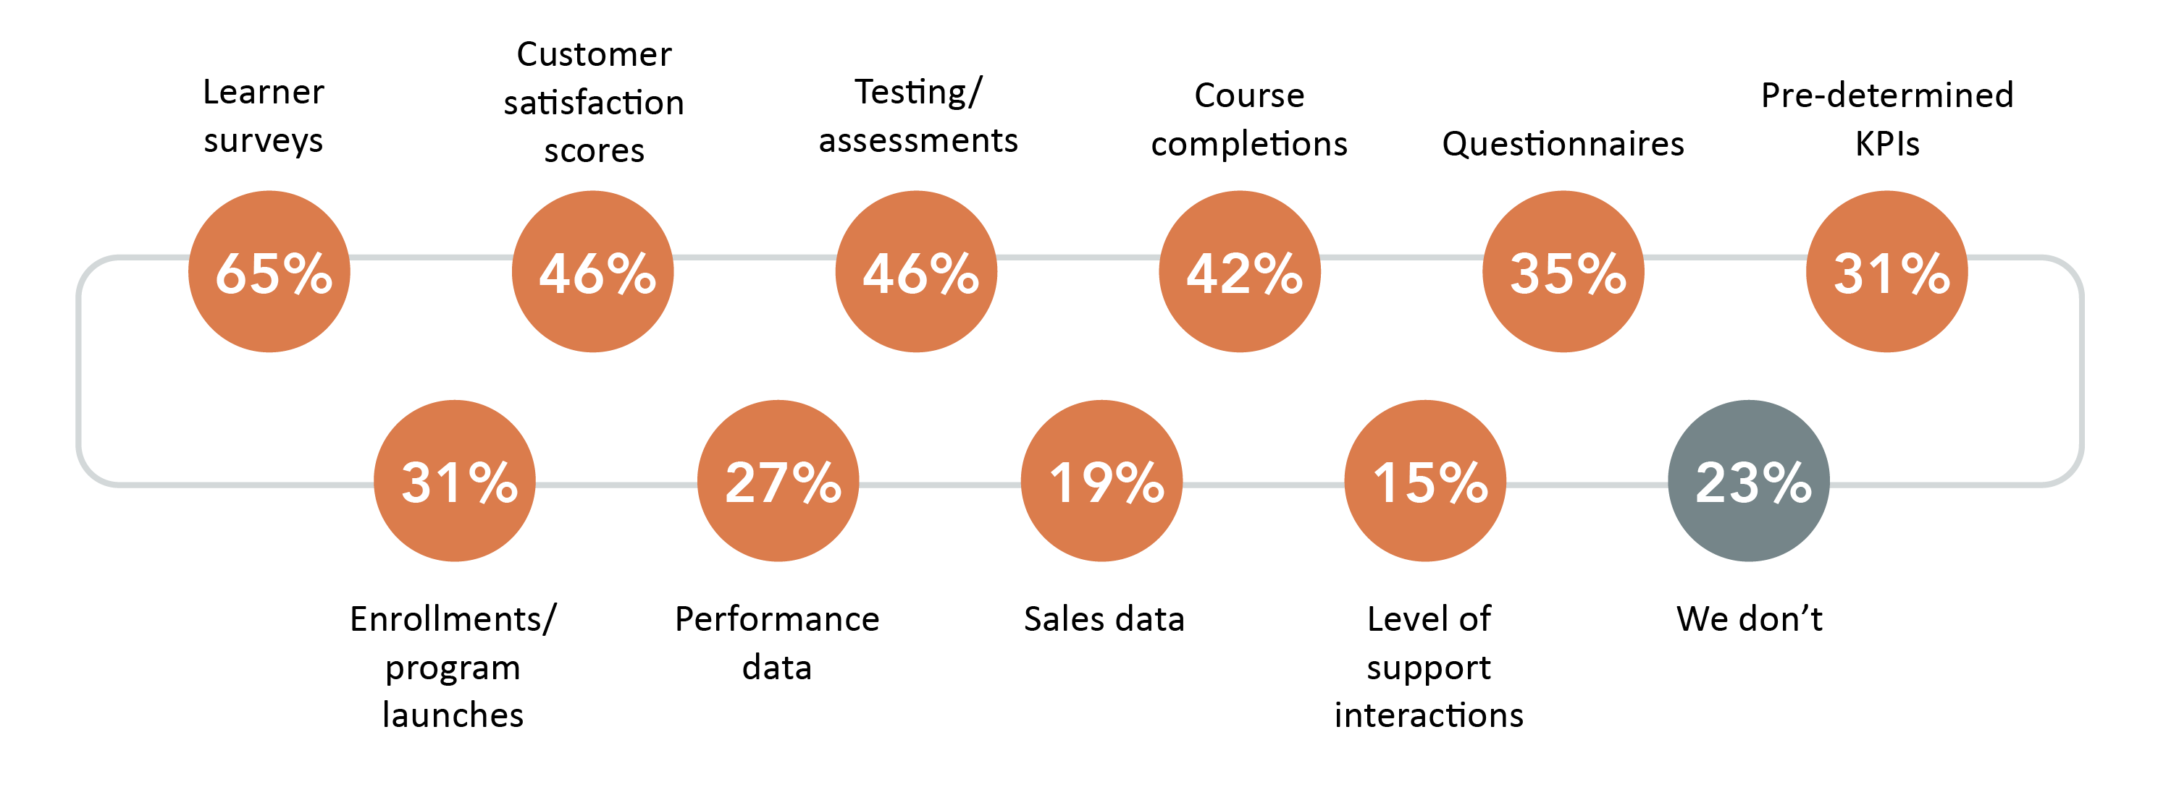
How do you measure the effectiveness of your extended enterprise learning?

Slide 13

Consequences
The extended enterprise represents a huge opportunity for L&D to have a direct impact on the bottom line of the business. It can be an integral part of the customer experience, helping to create happy, loyal customers, and thereby boosting sales. It can also be an extension of the marketing function which can drive the sales pipeline. Customers who receive excellent training rely less on support systems, increasing satisfaction and reducing cost. Properly trained sales partners are crucial to improving sales as well. L&D can even drive its own revenue by selling training to external audiences.

Slide 14
Which of the following are objectives of your organization's extended enterprise learning?

Slide 15
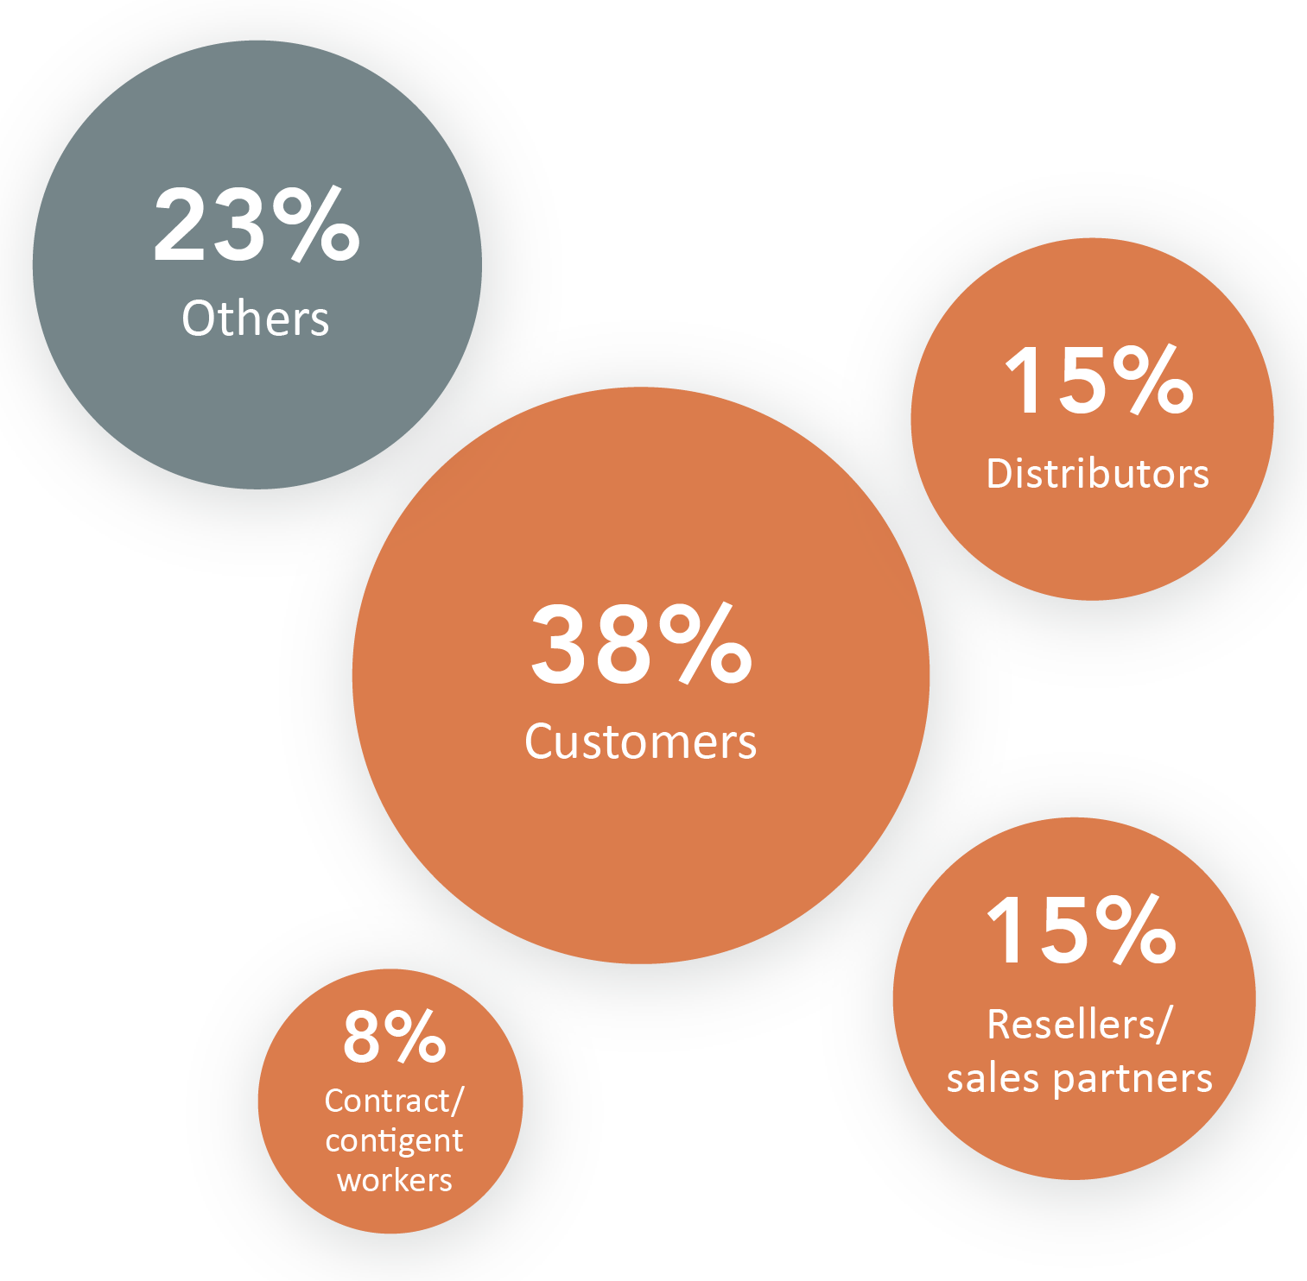
Please indicate which of the following external learning audiences you charge for content

Slide 16
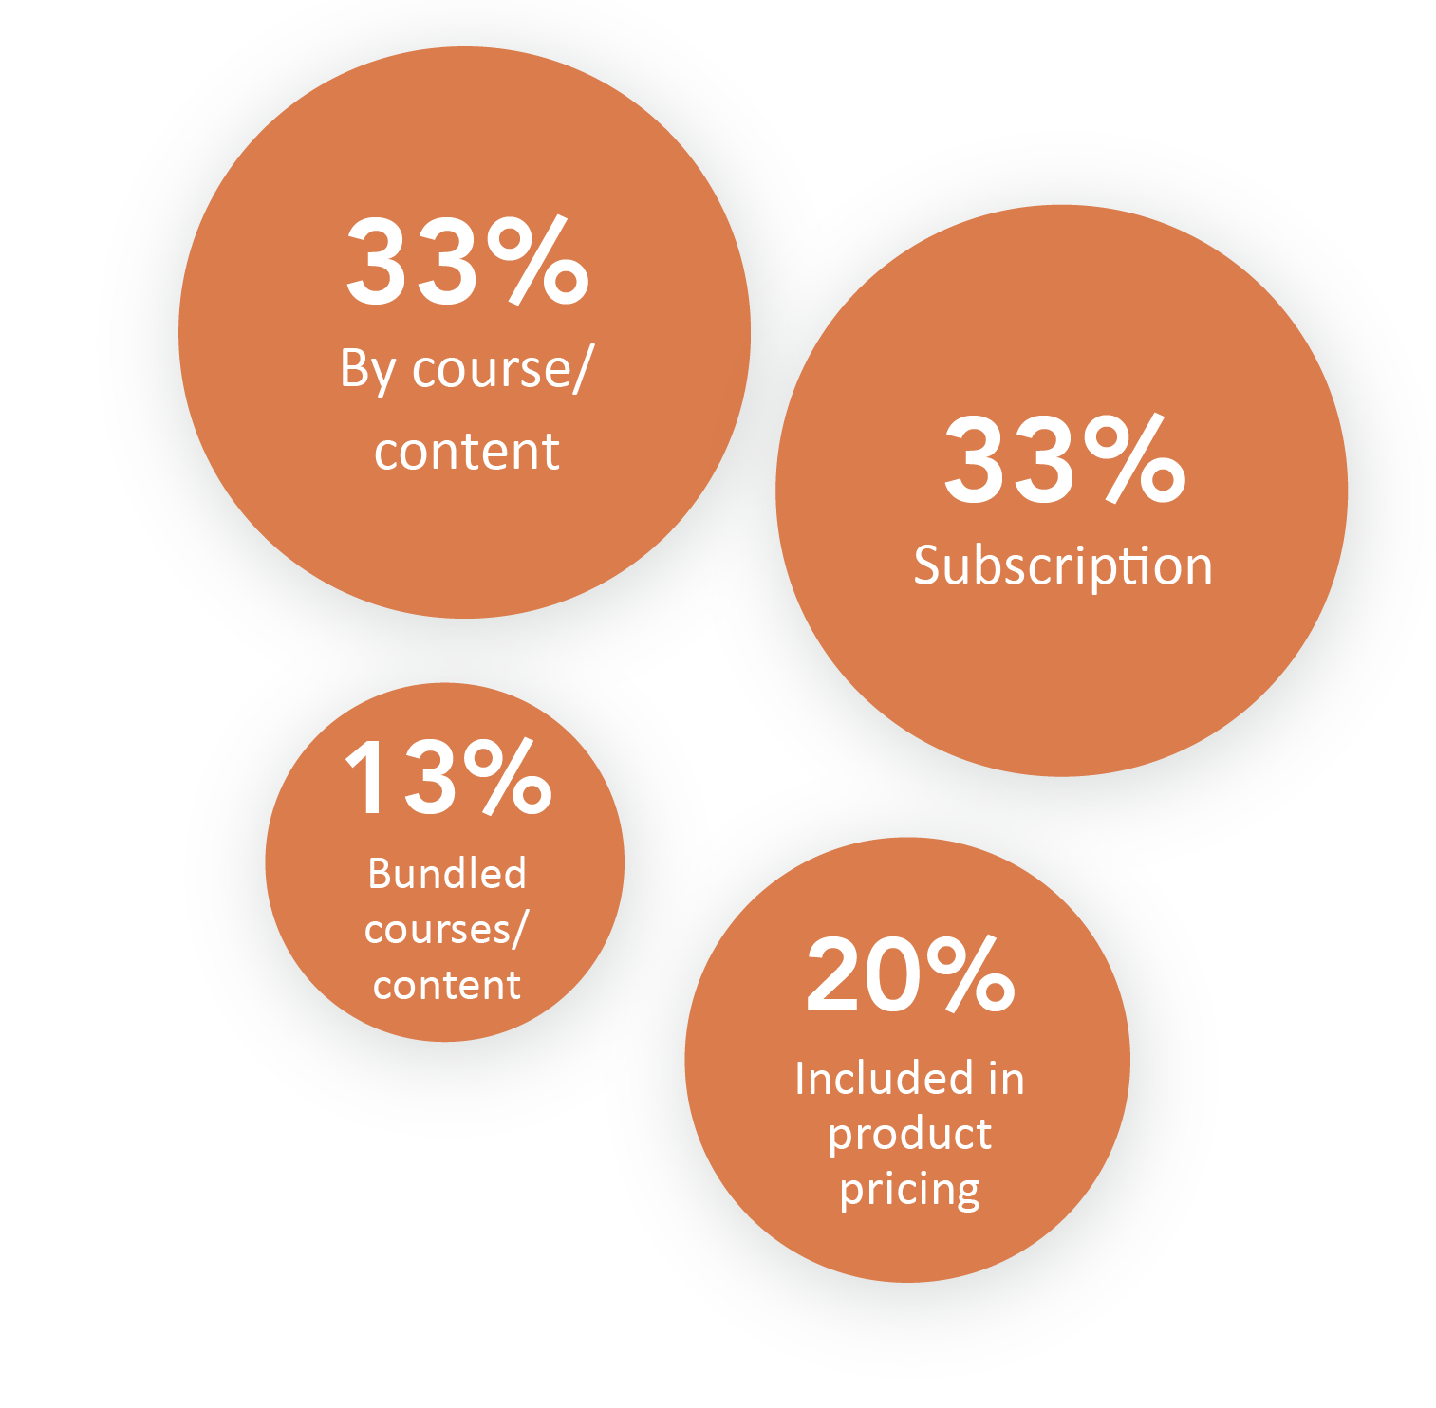
How does your organization charge for extended enterprise learning?

Slide 17
How does your extended enterprise learning help your business?

Slide 18
How does your organization measure return on investment (ROI) on your extended enterprise learning programs?

Slide 19

Critical Questions
To effectively deliver learning in an extended enterprise environment, organizations must answer several critical questions, including:
Are there audiences within the organization’s external ecosystem that would benefit from training developed by the organization?
How does the organization stand to benefit from training any or all of these groups?
Can we leverage our learning and development efforts externally to generate revenue?
Do we have the right technology/infrastructure to deliver to these audiences?
How do we measure the effectiveness of our efforts?

Slide 20
Brandon Hall Group Point of View
High-Level Strategies for Extended Enterprise Learning:
1
2
Build the business case behind delivering learning to specific external audiences.
Determine the business drivers behind delivering learning to specific audiences. If your organization needs to cut down on customer support inquiries, designing training specifically for them can reduce reliance on help tickets. Training manufacturers or distributors on how your products are made, used, or sold may help your supply chain run smoother. Giving reseller partners better and timelier information on your products or services could make them more likely to sell them over a competitor’s.
Identify your organization’s extended enterprise audiences and owners.
Based on the business cases, define the characteristics of each intended audience and determine their unique requirements. The learning ecosystem can be far larger than most companies realize, transcending employees to include resellers, manufacturers, customers, and even the public at large. For companies serious about brand awareness, delivering learning to the public is a key element of their marketing strategies. For organizations that invested heavily to create world-class training, there are opportunities to sell that training externally to defray learning costs.

Slide 21
Brandon Hall Group Point of View
High-Level Strategies for Learning and the Future of Work:
3
4
5
Look for technology that is designed to handle unique extended enterprise use cases.
Technology plays a key role in extended enterprise learning, but not every learning solution is built to handle this type of learning environment. Look for platforms with robust reporting, white labeling, mobile capabilities, and assessment tools that will maximize your efforts. The tools have to be able to meet the demands of multiple user audiences, as well as a decentralized network of admins and managers.
Determine if there is an opportunity to generate revenue, then define the system for doing so.
Companies must determine whether they are going to charge for the learning they deliver and how they will do it. It can be a chargeback system as part of a partnership, a subscription or a la carte model for outright purchasing, or built into the cost of the products/services delivered. The goal is to set expectations on the returns and having a process for recognizing the revenue. Price it right! This is new territory for many learning functions that may have only been delivering internally. Be sure to conduct the necessary market due diligence.
Make sure you have a framework and defined KPIs for measuring success.
It is difficult to measure learning within the organization. Once we begin talking about dispersed, disparate learning audiences, tracking becomes even more critical. Have a process and a set of KPIs before rolling out learning. For partner training, work together to set expectations for what metrics can be collected and what success looks like. For customer training, use metrics that are meaningful to the business.

Slide 22
Contributors
David Wentworth, Principal Learning Analyst
David focuses on all aspects of learning and the technology that supports it. David has been in the human capital field since 2005 and joined Brandon Hall Group 2012.
Michael Rochelle, Chief Strategy Officer
and Principal HCM Analyst
Prior to joining Brandon Hall Group, Michael was the Chief Strategy Officer and Co-founder at AC Growth. Michael serves in a variety of roles including overseeing consulting and advisory support for corporations and solution providers. Michael has led a wide range of advisory support and strategic engagements for Fortune 1000 and small- to medium-sized organizations as well as leading and emerging solution providers across the HCM industry. Michael is one of the company’s principal analysts covering the learning and development, talent management, leadership development, workforce management and talent acquisition sectors. Michael also leads the analyst coverage for solution providers in these sectors.
Mike Cooke, Chief Executive Officer
and Principal HCM Analyst
Prior to joining Brandon Hall Group, Mike was the Chief Executive Officer and Co-founder of AC Growth. Mike has held leadership and executive positions for the majority of his career, responsible for steering sales and marketing teams to drive results and profitability. His background includes more than 15 years of experience in sales and marketing, management, and operations in the research, consulting, software and technology industries.
Richard Pachter, Content Manager
Richard Pachter edited this report. He is the Content Manager at Brandon Hall Group and is responsible for editing all research assets and other content. He has experience as a journalist, copywriter, editor, marketer, blogger and social media marketing manager.
Rachel Cooke, Chief Operating Officer
Rachel is responsible for business operations, including client and member advisory services, marketing design, annual awards programs, conferences and the company’s project management functions. She also leads Advancing Women in the Workplace and Diversity, Equity and Inclusion initiatives, research and events. Rachel worked in the HCM research industry for 15+ years and held several key management and executive positions within the Talent and Learning Research and Performance Improvement industries.
Emma Bui, Graphic Design Associate
Emma Bui created the graphics and layout for this report.

Slide 23
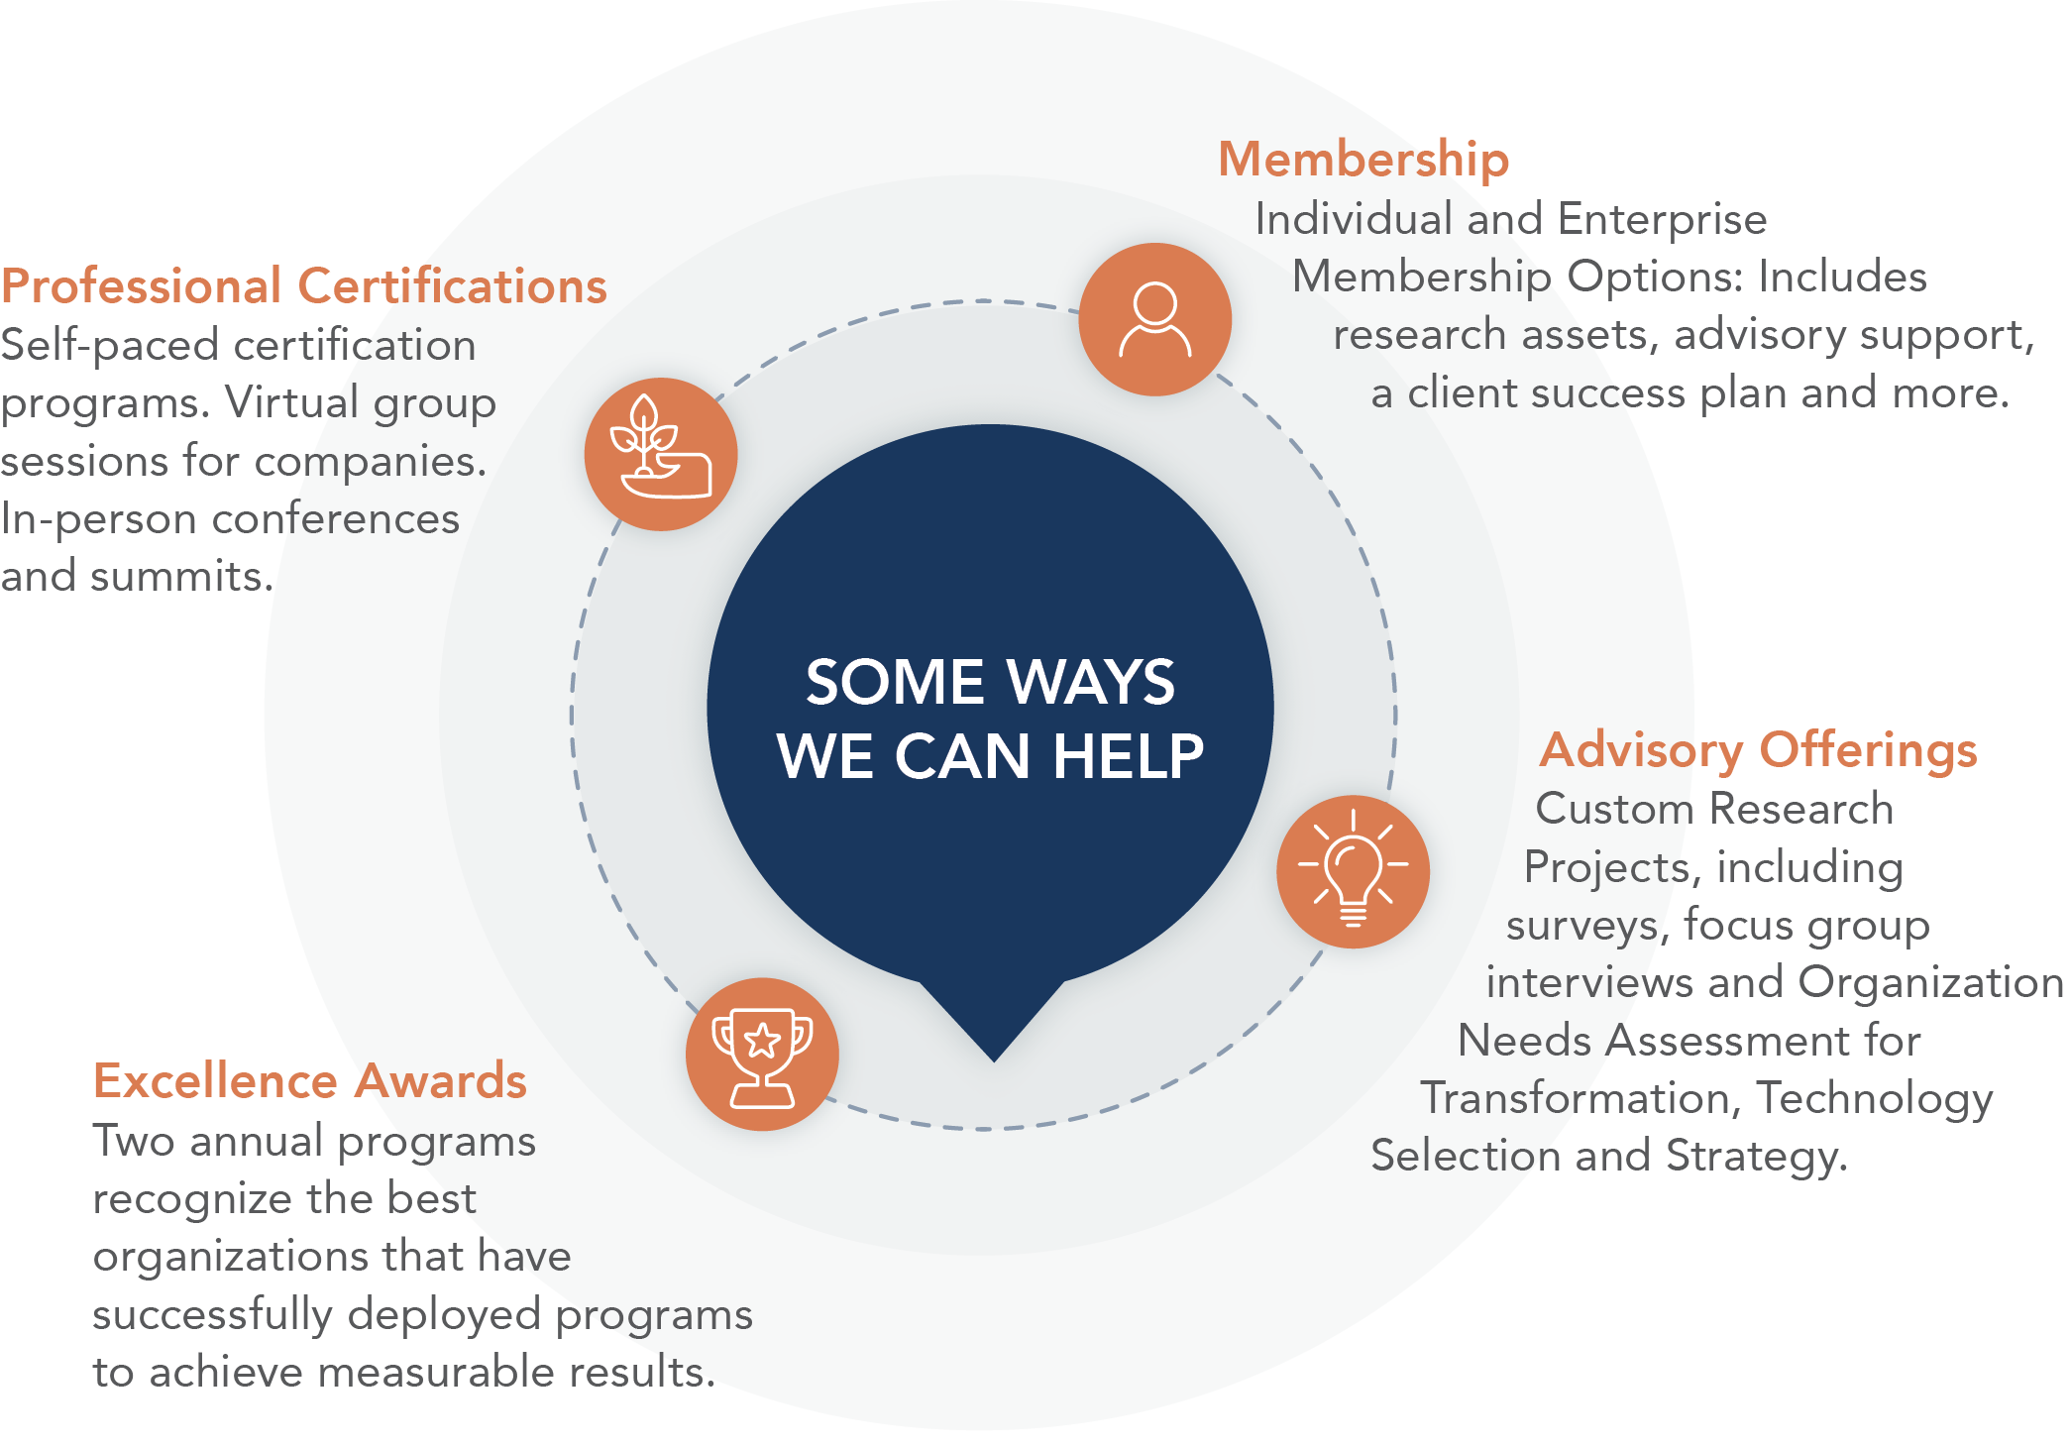
About
Brandon Hall Group
With more than 10,000 clients globally and 28 years of delivering world-class research and advisory services, Brandon Hall Group is focused on developing research that drives performance in emerging and large organizations and provides strategic insights for executives and practitioners responsible for growth
and business results.
ORGANIZATIONAL EXCELLENCE CERTIFICATION PROGRAM
recognizes world-class HCM programs that transform their organization and achieve breakthrough results. This designation is the next step beyond the HCM Excellence Awards, which focus on a single program, and looks at the department as a whole.
SMARTCHOICE® PREFERRED PROVIDER PROGRAM
uniquely places HCM service and technology companies at the top of organizations’ consideration list of vendors. It adds an unmatched level of credibility based on BHG’s quarter-of-a-century of experience in evaluating and selecting the best solution providers for leading organizations around the world.

