Slide 1

HR Playbook:
Mastering the Art and Science
of Strategic HR in the Age
of Innovation and Change
November 2024

Slide 2
Current State
HR Team Structure
HR has evolved into a strategic business partner, driving organizational performance and shaping the future of work. As organizations are grappling with multiple concurrent challenges that demand sophisticated HR responses, there has also been a fundamental shift in how HR functions conceptualize and execute their strategic mandate.
However, there is still opportunity and room for HR to shift their operational approach, given that nearly half of respondents are still operating in a centralized structure. Research clearly shows the hybrid approach creates success in learning by allowing for rapid response times, maximized technology investment and better outcomes. This approach is ultimately more agile, which is critical for HR teams to drive success.
Centralized
40%
Decentralized
14%
Hybrid
41%
Outsourced
5%
HR administration, resources, processes and technology are consolidated under a single executive.
Source: Brandon Hall Group™ Study, HR Playbook

Slide 3
HR Metric Alignment
Further evidence of HR’s transformation journey is the question of alignment. HR metrics are business metrics and should be a reflection of the effort of people to deliver results. No longer are “people numbers” just about people. They are a sign of the health of the workforce. Progress has been made, but there is more to do. It is troubling when an equal percentage of survey respondents say HR metrics are completely aligned with the business and not at all aligned. If you cannot align your metrics with the business results, how can you possibly impact that business for the better?
All
14%
Not at all
15%
Most
39%
Some
26%
Source: Brandon Hall Group™ Study, HR Playbook

Slide 4
Drivers of HR Digitalization
Greater need for people analytics
Increased workforce globalization
Greater need for technology support
Changing business conditions
Increased workforce diversity
Increased workforce mobilization
Changing compliance/regulatory conditions
Support of the gig economy
HR functions are undergoing a digital revolution, leveraging AI, machine learning and automation to streamline processes and enhance decision-making. The digitization of HR is being driven by a number of factors, but the end result is a team that is better able to respond to changes and challenges quickly.
65%
59%
58%
56%
55%
49%
46%
29%
Source: Brandon Hall Group™ Study, HR Playbook

Slide 5
In response to the ongoing challenges, staffing is healthy. Also somewhat surprising is the fact that about one-third of organizations are planning some level of increase to their HR staffing levels over the next 12 months. In an era that has been marked by a lot of staffing corrections and reductions in response to tighter financial circumstances, seeing organizations increasing HR staffing is an encouraging sign.
Current HR Staffing Ranges
Under 10,000 employees
2%
29%
12%
18%
8%
4%
27%
1-20
21-50
51-100
101-250
251-500
501-1,000
1,000+
16%
8%
8%
11%
15%
42%
Over 10,000 employees
0%
Source: Brandon Hall Group™ Study, HR Playbook

Slide 6
Projected HR Staffing Changes Over the Next 12 Months
Increase by >25%
6%
Increase by 11-25%
3%
Decrease by >25%
16%
Increase by 6-10%
11%
Decrease by 11-25%
3%
Decrease
4%
4%
3%
16%
Increase
15%
11%
3%
6%
1-5%
6-10%
11-25%
>25%
Decrease by 6-10%
4%
Decrease by 1-5%
4%
Increase by 1-5%
15%
Source: Brandon Hall Group™ Study, HR Playbook
No change planned
38%

Slide 7
Complexities
HR Upskilling Priorities, Next 12 Months
The technological revolution sweeping through HR departments requires teams to master an ever-expanding array of digital solutions while ensuring seamless integration with existing systems and maintaining rigorous data privacy standards. This shift occurs against the backdrop of unprecedented workforce diversity, with five generations working side by side, each bringing distinct expectations, work styles and career aspirations. The traditional employer-employee relationship is undergoing a fundamental transformation, complicated further by the rise of contingent workers and globally distributed teams.
This puts a lot of pressure on HR teams to upskill to meet this demand. Priorities for upskilling reflect an HR professional keeping pace with change, looking to the future and anticipating what’s next and investing time and energy in helping the workforce navigate those transitions. These upskilling priorities also reflect the critical importance of data for decision-making, story-telling and success.
Strategic planning and execution
Coaching/mentoring
Learning agility
Leadership/change advocacy
Collaboration
Data science
Business acumen
Inclusiveness
Consulting
Design thinking
Digital dexterity
Ideation
62%
60%
60%
57%
51%
51%
49%
49%
44%
43%
39%
32%
Source: Brandon Hall Group™ Study, HR Playbook

Slide 8
HR Readiness to Address Current and Future Workplace Needs
Adding to these challenges is the acceleration of business model innovation and organizational change, requiring HR teams to become more agile and responsive than ever before. The persistent war for talent has intensified in a market where skills gaps widen as quickly as technology advances, forcing organizations to fundamentally rethink their approach to talent development and retention.
The emergence of remote work also has brought employee well-being and mental health to the forefront of HR concerns, while simultaneously raising new questions about virtual team dynamics and digital collaboration. These multifaceted challenges demand that HR professionals not only serve as strategic partners in organizational success but also as guardians of employee data, architects of learning initiatives and stewards of workplace culture.
Current Needs
26%
48%
25%
1%
Completely
Mostly
Somewhat
Not Ready
29%
34%
32%
5%
Future Needs
Source: Brandon Hall Group™ Study, HR Playbook

Slide 9
Implications
Organizations must cultivate a sophisticated array of capabilities that merge technological innovation with human-centered approaches. At the foundation lies strategic workforce planning, where predictive analytics and scenario-based planning enable organizations to anticipate and adapt to changing talent needs.
The implementation of internal talent marketplaces and flexible organizational structures provides the agility needed to respond to rapid market shifts while maximizing internal capability development. This forward-looking approach to workforce management continues to be underpinned by robust digital transformation initiatives that modernize not just technology infrastructure, but the entire employee experience.
Companies are seeing mixed responses in AI’s impact and effectiveness. Of biggest concern are those companies that are seeing no impact, which amounts to about one in five. AI is not going away; it has forever altered how we approach work, and HR must not only embrace it but lead the way in responsible and effective use of AI in business.
The success of HR initiatives hinges on cultivating strong organizational cultures and leadership capabilities that can drive and sustain transformation. Organizations must develop leaders who can foster inclusivity, navigate change and build adaptive cultures that resonate with a diverse workforce. This cultural evolution needs to be supported by compelling employee value propositions and data-driven decision-making processes that align HR strategies with broader business objectives.
The key to success lies in maintaining an employee-centric approach while leveraging technological advances, ensuring that automation and AI enhance rather than replace the human element in HR processes. This balanced approach, combining strategic foresight with operational agility, enables organizations to build resilient, future-ready workforces capable of thriving in an increasingly dynamic business landscape.

Slide 10
Critical Questions
How effectively does your current HR operating model align with emerging business needs and workforce expectations?
How does your talent strategy account for the increasing complexity of workforce dynamics, including multi-generational management, remote work and evolving skill requirements?
What is your organization’s readiness level for implementing data-driven HR practices, and how will you address any technological or capability gaps in your HR function?
What specific metrics and accountability systems are in place to measure the effectiveness of your HR initiatives, particularly in areas such as DEI, employee engagement and leadership development?
What is your organization’s readiness level for implementing data-driven HR practices, and how will you address any technological or capability gaps in your HR function?
How prepared is your HR function to support rapid business model innovation and organizational change while maintaining employee engagement and cultural cohesion?
2024 Brandon Hall Group™. Not Licensed for Distribution.

Slide 11
Brandon Hall Group™ Point of View
Modernize the HR Operating Model
Accelerate HR Digital Maturity
Organizations must transition to a multi-tiered HR operating model that combines strategic centers of excellence, agile business partnering and efficient shared services. This model should be supported by clear governance structures and decision-making frameworks that enable rapid response to changing business needs while maintaining operational excellence. Success requires designating 30% of HR resources to strategic initiatives while leveraging technology to automate 40% of transactional activities.
Companies should prioritize establishing an integrated HR technology ecosystem over the next 18-24 months, focusing on cloud-based solutions that enable predictive analytics and AI-driven insights. This includes implementing a unified HRIS platform, developing data visualization capabilities and ensuring at least 75% of HR processes are digitized. Critical to success is investing in HR team capabilities, with the goal of having the great majority of HR professionals proficient in data-driven decision-making in 2025.
2024 Brandon Hall Group™. Not Licensed for Distribution.

Slide 12
Deploy an Adaptive Talent Strategy
Organizations must implement a dynamic talent strategy that combines internal talent marketplace principles with strategic workforce planning. This approach should include quarterly talent reviews, skills-based career pathways and hybrid work policies that optimize for both flexibility and collaboration. Success metrics should include filling a majority of key roles through internal mobility and significantly reducing time-to-productivity for new roles.
Build Change-Ready HR Capabilities
Organizations must develop dedicated change management capabilities within HR, including certified change practitioners and agile project teams. This includes establishing a team focusing at least part-time on increasing HR innovation, developing rapid prototyping capabilities for new initiatives and maintaining a portfolio of strategic HR projects aligned with business transformation goals. Success requires allocating 15-20% of HR resources to transformation initiatives and maintaining a continuous learning ecosystem for HR professionals.
Establish Measurable Impact Frameworks
Companies should implement comprehensive HR analytics frameworks that track both leading and lagging indicators across all major people initiatives. Key metrics should include quality of hire, leadership pipeline strength, DEI progress and employee experience scores. Organizations should aim for 100% transparency in metric reporting and establish quarterly review cycles that tie HR outcomes directly to business performance indicators.
2024 Brandon Hall Group™. Not Licensed for Distribution.

Slide 13
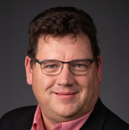

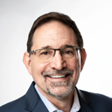



Contributors
Matt Pittman, Principal Analyst
Matt brings nearly 30 years of experience developing people and teams in a variety of settings and organizations. As an HR Practitioner, he has sat in nearly every HR seat. A significant part of those roles involved building out functions in organizations and driving large-scale change efforts. As a Principal Analyst at Brandon Hall Group™, Matt leverages this in-depth experience and expertise to provide clients and providers with breakthrough insights and ideas to drive their business forward.
Mike Cooke, Chief Executive Officer and Principal HCM Analyst
Prior to joining Brandon Hall Group™, Mike was the Chief Executive Officer and Co-founder of AC Growth. Mike has held leadership and executive positions for the majority of his career, responsible for steering sales and marketing teams to drive results and profitability. His background includes more than 15 years of experience in sales and marketing, management, and operations in the research, consulting, software and technology industries.
Claude Werder, Senior VP and Principal Analyst
Claude Werder runs Brandon Hall Group’s Talent Management, Leadership Development and DEI practices, focusing on solving corporate’s challenges in developing and retaining talent. He takes a strategic, unified approach, with a keen eye on leveraging technology to drive efficiencies that enable leaders to better engage employees and drive performance.
Rachel Cooke, Chief Operating Officer and Principal HCM Analyst
She is responsible for business operations, including client and member advisory services, marketing design, annual awards programs, conferences and the company’s project management functions. She also leads Advancing Women in the Workplace and Diversity, Equity and Inclusion initiatives, research and events. Rachel worked in the HCM research industry for 15 years and held several key management and executive positions within the Talent and Learning Research, and Performance Improvement industries.
Michael Rochelle, Chief Strategy Officer and Principal HCM Analyst
Prior to joining Brandon Hall Group™, Michael was the Chief Strategy Officer and co-founder at AC Growth. Michael serves in a variety of roles including overseeing consulting and advisory support for corporations and solution providers. Michael has led a wide range of advisory support and strategic engagements for Fortune 1000 and small- to medium-sized organizations as well as leading and emerging solution providers across the HCM industry. Michael is one of the company’s principal analysts covering the learning and development, talent management, leadership development, workforce management and talent acquisition sectors. Michael also leads the analyst coverage for solution providers in these sectors.
Pat Fitzgerald, Content and Community Coordinator
Prior to joining Brandon Hall Group™, he was an award-winning community journalist for 30 years and recognized for his writing, investigative reporting, editing, photography, design and community service. He also started and then sold his own successful weekly newspaper in the Branson, Mo., area.
2024 Brandon Hall Group™. Not Licensed for Distribution.

Slide 14
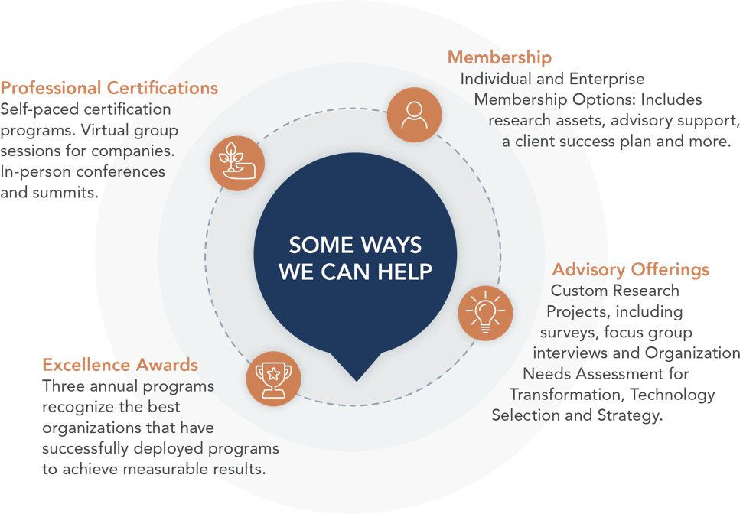
About
Brandon Hall Group™
With more than 10,000 clients globally and 30 years of delivering world-class research and advisory services, Brandon Hall Group™ is focused on developing research that drives performance in emerging and large organizations and provides strategic insights for executives and practitioners responsible for growth and business results.
AGENCY! BY BRANDON HALL GROUP™
Provides comprehensive marketing solutions for human capital management solution providers. We offer strategic services to establish a strong foundation for your marketing efforts.
SMARTCHOICE® PREFERRED PROVIDER PROGRAM
uniquely places HCM service and technology companies at the top of organizations’ consideration list of vendors. It adds an unmatched level of credibility based on BHG’s 30 years of experience in evaluating and selecting the best solution providers for leading organizations around the world.
ENTERPRISE EXCELLENCE CERTIFICATION PROGRAM
recognizes the best HCM programs that transform their organization and achieves breakthrough results. This designation is a step above the HCM Excellence Awards® which focuses on one program within a company. Enterprise Excellence is a hybrid of award winners who are also members.
AGENCY! BY BRANDON HALL GROUP™
Provides comprehensive marketing solutions for human capital management solution providers. We offer strategic services to establish a strong foundation for your marketing efforts.

